Slide 1
Vanier Canada Graduate Scholarship Information Session
School of Graduate Studies
Memorial University
September 2021

Slide 2
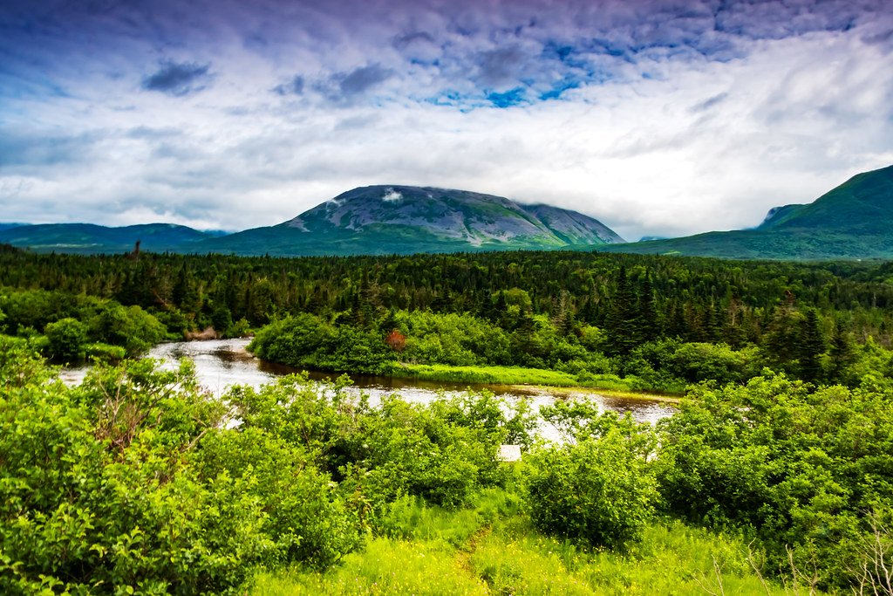
Land Acknowledgement
We respectfully acknowledge the territory in which we gather as the ancestral homelands of the Beothuk, and the island of Newfoundland as the ancestral homelands of the Mi’kmaq and Beothuk. We would also like to recognize the Inuit of Nunatsiavut and NunatuKavut and the Innu of Nitassinan, and their ancestors, as the original people of Labrador. We strive for respectful relationships with all the peoples of this province as we search for collective healing and true reconciliation and honour this beautiful land together.
We also encourage everyone here today to reflect on the lands where you are located, no matter where in the globe, and the Indigenous peoples for whom those lands are traditional territory

Slide 3
Welcome
Dr. Beverly Diamond, Professor Emeritus of Ethnomusicology
Dr. Robert Bertolo, Professor and Deputy Head of Biochemistry
Dr. Eric Vander Wal, Associate Professor of Biology
Carol Sullivan, BBA, MBA, Manager of Awards and Scholarships, School of Graduate Studies (SGS)
Moderator: Chelsee Arbour, Special Projects Coordinator, School of Graduate Studies (SGS)

Slide 4
Today’s plan
Brief overview of the Vanier Canada Graduate Scholarship
Discussion of Eligibility
Application components
Award Criteria
Leadership
Application Process
Times/Submission deadlines
Writing Workshop
Questions with our expert guests
**We will not discuss the mechanics of writing – that is the focus of the writing workshop

Slide 5
Brief Overview of the Vanier Scholarship
Purpose:
“The Government of Canada launched the Vanier Canada Graduate Scholarships (Vanier CGS) program in 2008 to strengthen Canada's ability to attract and retain world-class doctoral students and establish Canada as a global center of excellence in research and higher learning. Vanier Scholars demonstrate leadership skills and a high standard of scholarly achievement in graduate studies in the social sciences and humanities, natural sciences and/or engineering and health.”
Value:
$50,000.00 per year for up to 3 years (non-renewable)
Scope:
Up to 166 awards per year
Memorial Quota:
NSERC=2
SSHRC=2
CIHR=1

Slide 6
Eligibility:
Canadian citizens/permanent residents, & students whose home country is outside of Canada
Intent to pursue studies and research during summer semester or academic year following the competition results
First Doctoral degree
Completed less than 20 months of doctoral studies (as of May 1st, 2022)
First class average in each of last 2 years of full- time study (MUN = 3.5 minimum)
Vanier Eligibility webpage

Slide 7
Eligibility:
Remain enrolled and demonstrate satisfactory progress
Cannot hold, or have held, doctoral funding from CIHR, NSERC, or SSHRC to pursue a doctoral degree
Have not received a previous, doctoral-level award from NSERC, SSHRC, or CIHR
Must be nominated by MUN (SGS)
Registered full-time
Vanier Eligibility webpage

Slide 8
Eligibility:
It is important to remember that departmental or SGS base funding will be replaced by Vanier yearly funding as well as a $5000.00 yearly Dean’s Excellence Award for successful candidates
You cannot hold MUN base funding in addition to the Vanier award and the Dean’s Excellence Award

Slide 9
Application package:
Application details (form)
Research contributions – maximum one page (written by the student)
Canadian common CV (CCV) Online)
Personal Leadership Statement – maximum two pages (self-evaluation written by the student)
Special circumstances
(optional) – maximum one page (written by the student)
Two Leadership reference Letters – maximum two pages each (written by someone who knows the candidate in a non-academic capacity – this letter is attached to the nomination by the candidate)

Slide 10
Application package:
Research proposal – maximum two pages (written by the student)
Project references – maximum five pages (written by the student)
Two Academic reference Letters – three sections each (written by someone who knows the candidate in an academic capacity)
Institution transcripts (scanned and attached by the institution’s administrative staff)
Nomination letter – maximum two pages (Provided by SGS and signed by the relevant department head of the nominating institution)

Slide 11
Canadian Common CV
Some sections of the CCV has limits to how many entries you can make:
Publications: 20
Artistic Contribution: 10
Presentations: 10
Interviews and Media Relations: 10
Intellectual Property: 5
Activities: 5
Memberships: 5
BUT there are no limits for other sections of the CCV

Slide 12
Proposal information
The Title of Research Proposal: used by the Vanier CGS program to identify research project
The Lay Title used to inform public and Parliament about valuable research supported by public funds.
The Lay Abstract used for promotional purposes outside research community to inform public and Parliament about the research supported by public funds. Summarize research in in clear, plain language.
Using simple terms, describe nature of the work to be done. Indicate why and to whom the research is important, anticipated outcomes, and how the research will contribute to field.
If your research involves and engages Indigenous communities, you must include the following text at the beginning of the abstract: “This research respectfully involves and engages Indigenous communities…”

Slide 13
Attachments
Research Proposal (2 pages: what, how, & why)
Project References (5 pages: references cited in research proposal)
Personal Leadership Statement (2 pages: impact of accomplishments, communication and leadership skills)
Research Contributions (1 page: role, impact & significance of contributions)
Special Circumstances (if applicable) (1 page)
*ALL of these must follow Vanier CGS-D Presentation Standards for Documents

Slide 14
Letters of Reference (4)
For more information on Referee Assessment, please click here.
Two Academic References:
Referees must know you well, be able to comment on quality of your work (academic excellence, research potential, leadership) and support their assertions with examples
ResearchNet does not allow referees to access the full application, only the referee page.
You cannot submit your application until these letters have been completed

Slide 15
Letters of Reference (4)
For more information on Referee Assessment, please click here.
Two Leadership Reference Letters:
Should be someone who knows you in non-academic capacity;
The letters must be more than a list of duties;
They must speak to leadership potential & your research project
Letters must be given to the applicant (you) for uploading as a PDF to ResearchNet and must be uploaded one letter at a time (i.e. 2 separate PDFs)
Be sure to contact your referee’s as early as possible to secure their reference. Once they agree, provide a copy of your full application so that they can speak to the selection criteria on your behalf

Slide 16
Notes on Transcripts
Transcripts must:
Be official and complete transcripts for all post-secondary studies up to August 31st, 2021
Include any information (often on reverse) on grading systems/keys
Be submitted to Gail Lamkin at SGS on or before September 27th, 2021
Official MUN transcripts are $10.00 and can be requested through self-service (Student menu >Academic Information > Request Official Transcript). Requests are processed by order of requesting date/time but the normal processing time is roughly two business days.
Other Universities request process for official transcripts will vary; be sure to give yourself enough time to request and receive your official transcripts before the internal deadline!

Slide 17
Vanier Award Criteria: 1.Academic Excellence
For more information on selection criteria please click here.
First Class standing (transcripts)
Academic scholarships, awards, prizes, and distinctions
Previous study (academic background, duration & special circumstances)

Slide 18
Vanier Award Criteria: 2.Research Potential
For more information on selection criteria please click here.
Awards & scholarships (included on Canadian Common CV)
Academic training & relevant work experience
Research proposal (feasibility, merit & significance)
Contributions to research and development
Critical thinking, app. of knowledge, judgement, originality, initiative, autonomy, enthusiasm for research

Slide 19
Vanier Award Criteria: 3.Leadership
For more information on selection criteria please click here.
Personal achievement
Involvement in academic life
Volunteerism/Community outreach
Civic engagement
Goal Achievement
Self-management
Integrity
Other Traits (creativity, courageous, strategic, problem solver etc.)
Social Skills

Slide 20
Notes on Leadership component
Leadership examples:
How you have created opportunities for yourself and others
How you have overcome obstacles to your vision
How your PhD research, knowledge dissemination and mentorship activities will help accomplish new goals
How have you lead others, and how have you leveraged that skill?
What led you to doctoral research? How have your life experiences and personal circumstances (which may include administrative responsibilities, maternity/parental leave, childrearing, illness, cultural or community responsibilities, socio-economic context, trauma and loss, or health-related family responsibilities) shaped your academic, research, and leadership choices, challenges, and successes?
How has your life driven you to share and disseminate your research?

Slide 21
Tips from Vanier about Leadership
Accomplishments
Outline not just your accomplishments for the committee, but how those accomplishments required you to leverage your leadership skills to achieve your goals.
Above and beyond
Outline how you have gone above and beyond the expected norms in those areas in order to overcome obstacles, foster others, spearhead change, or otherwise demonstrate leadership.
Tell your story
Craft a compelling narrative that tells your story of how you have had an impact.

Slide 22
Past Winner’s Leadership experience
Organizing/participating in volunteer activities (87%)
Taking on an administrative role (77%)
Promoting awareness for a particular cause (75%)
Participating in institutional associations (75%)
Educating youth or community groups (72%)
Participating in civic initiatives (65%)
Taking a leadership role in campus activities (57%)
Holding a position in a professional organization (47%)
Participating in campus media (46%)
Developing & executing a fundraiser (43%)

Slide 23
Timeline/deadlines
For more information on the selection committee please click here.
September 27th, 2021
Completed applications due at SGS (including all official transcripts)
November 2nd, 2021
Deadline for institutions to submit applications
April early, 2022
Results released

Slide 24
Tips
Start now
Read ALL the instructions
Get transcripts
Contact letter writers
Seek advice on Program of Study
Proofread everything multiple times &
Get someone other than you to proof

Slide 25
Questions for our experts?
Dr. Beverly Diamond, Professor Emeritus of Ethnomusicology
Dr. Robert Bertolo, Professor and Deputy Head of Biochemistry
Dr. Eric Vander Wal, Associate Professor of Biology
Carol Sullivan, BBA, MBA, Manager of Awards and Scholarships, School of Graduate Studies (SGS)

Slide 26
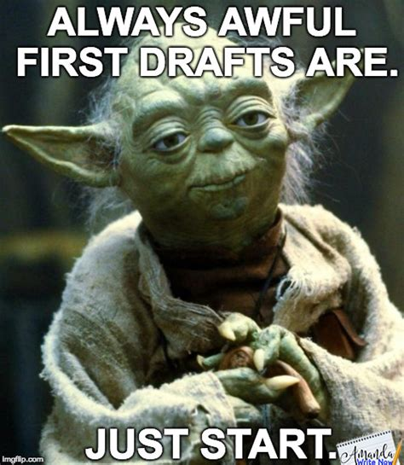
Writing Workshops
Two online writing workshops will be held on September 16th (12:00-3:00pm; 6:00-9:00pm) through Webex.
These workshops will cover the same material but participants are welcome to attend both.
Writing Centre tutor Jacinda Sinclair and Chelsee Arbour from SGS will facilitate and provide feedback.
These workshops will focus on:
Writing resources for grant applications
Examples of successful Vanier applications
How to guides for writing different sections of your grant
Review and editing tips to polish your piece
Writing exercises
Peer review
You can register through the awards and scholarship page

Slide 27
Thank you for joining us and all the best with your application preparation!!!

