Slide 1
Canada Graduate Scholarship – Doctoral Writing Workshop
School of Graduate Studies
The Writing Centre
Memorial University

Slide 2
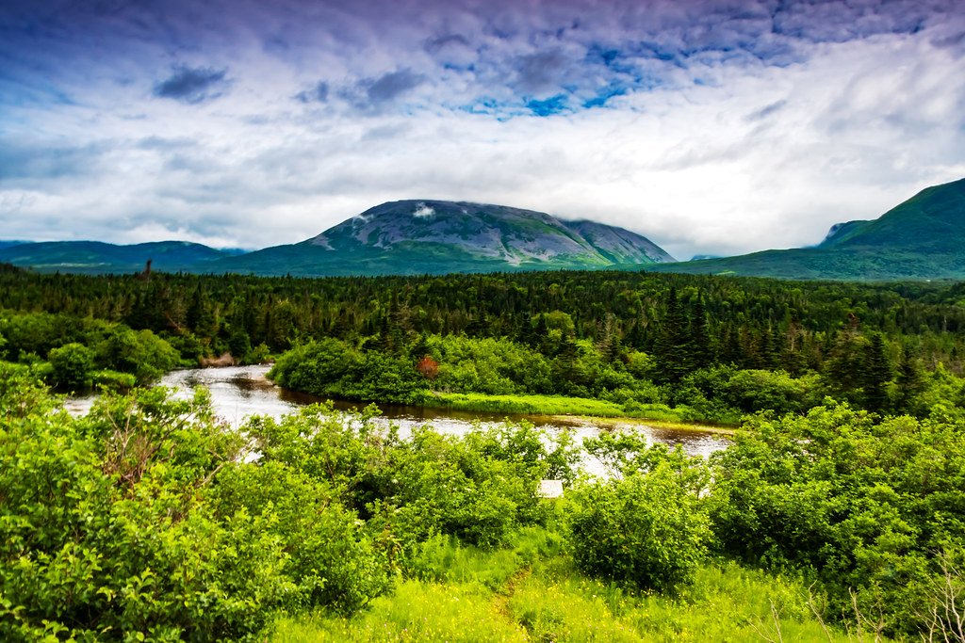
Land Acknowledgement
We respectfully acknowledge the territory in which we gather as the ancestral homelands of the Beothuk, and the island of Newfoundland as the ancestral homelands of the Mi’kmaq and Beothuk. We would also like to recognize the Inuit of Nunatsiavut and NunatuKavut and the Innu of Nitassinan, and their ancestors, as the original people of Labrador. We strive for respectful relationships with all the peoples of this province as we search for collective healing and true reconciliation and honour this beautiful land together.
We also encourage everyone here today to reflect on the lands where you are located, no matter where in the globe, and the Indigenous peoples for whom those lands are traditional territory

Slide 3
Welcome
Who we are:
Jacinda Sinclair, Writing Centre graduate peer tutor, Masters Candidate in Archaeology
Bryan Heystee, PhD candidate in Philosophy
Chelsee Arbour, Special Projects Coordinator, School of Graduate Studies (SGS)

Slide 4
Overview
Eligibility and the Canada Graduate Scholarship – Doctoral
Grant do’s and don’ts
Canada Graduate Scholarship - Doctoral application package
Canada Graduate Scholarship - Doctoral formatting criteria
How to build a research proposal
What goes into a research contributions page
Editing tips and tricks

Slide 5
Eligibility:
Canadian citizens/permanent residents and protected persons
Completed no more than 24 months of doctoral studies (as of December 1st, 2021) or no more than 36 months of a joint program (MA/PhD, MD/PhD, BA/PhD, BSc/PhD
Cannot hold, or have held, doctoral funding from CIHR, NSERC, or SSHRC to pursue a doctoral degree
Can only submit a maximum of one scholarship application per academic year to either CIHR, NSERC or SSHRC
Registered full-time

Slide 6
Reminders:
It is important to remember that departmental or SGS base funding will be replaced by the CGS-D yearly funding as well as a $5000.00 yearly Dean’s Excellence Award for successful candidates
You cannot hold MUN base funding in addition to the CGS-D award and the Dean’s Excellence Award

Slide 7
Why do some applications receive funding over others?
Things you cannot control:
Who is on the CGS-D review committee
Whether they are in a positive state of mind when they review your application
Whether they have the discipline specific knowledge to critique your application on presentation, idea, and disciplinary knowledge
Whether your research is considered a ‘hot topic’

Slide 8
Why do some applications receive funding over others?
Things you can control:
Whether you present your idea clearly and with sufficient detail
Whether your application is complete
Whether you have a unique idea that is achievable in the timeframe allotted (i.e. schedule)
Whether you have the necessary resources to complete the project in that time (i.e. resources and budget)

Slide 9
Grant writing: Do’s
The easier you make it for the reviewers, the more they want to fund you; Clarity is hugely important; Focus (avoid vagueness); Do-able/realistic idea (avoid overambitious research designs)
Captivate: something that will engage the reader (memorable); bring them in.
Should be a short narrative, but one that can be followed from beginning to the end (research narrative)
There must be order to the process: clear structure according to the selection criteria of the grant
In short, it should be a realistic, do-able topic that is highly focused and clear to the reviewers

Slide 10
Grant writing: Do’s
Become a student of grant; research what the sponsors strategic plan, research their mandate, know there mission statement, learn the grant specific guidelines, understand the eligibility criteria, and research previously funded projects.
It is always smart to give the sponsor their language back (i.e. if grant calls for innovative models, describe how your work includes innovative modeling).
Address fundamental research challenges
Discuss your quality contributions, when appropriate
Discuss impact of your research (does it build upon or expand our knowledge? is it capable of making a difference? i.e. breath and scope, advancement of knowledge, betterment of society, etc.,

Slide 11
Grant writing: Do’s
Organize the attachments using the proper formatting standards, and use section headings outlined in the instructions.
If it is a team based project, know your team and think though everyone’s responsibilities.
Test the waters by talking with peers, mentors, etc. Peer review should be completely understandable regardless of discipline (i.e. is it understandable, can you follow what is trying to be done, is it fully explained without reliance on high jargon)?
Only ever submit your best work – do not do a throw away proposal to see how you would do…

Slide 12
Grant writing: Do’s
If your research makes a clear contribution to Canada and/or to the betterment of society, make sure to highlight it! It is a good idea to review “Equity, diversity, and inclusion” section prior to writing your research proposal and addressing those aspects in your own research
In the Lay Abstract, summarize research in in clear, plain language to describe nature of the work to be done. Indicate why and to whom the research is important, anticipated outcomes, and how the research will contribute to field.
Give yourself the necessary time to construct a strong application

Slide 13
Grant writing: Don’ts
Do not wait until the last minute to start your application – give yourself plenty of time (a month is good, 3 months is better)
Do not use jargon. Write for a well-educated person who may not be an expert in your field.
Do not include objectives that are too ambitious in scope and that do not match the objectives of the funding source.
Do not prepare a proposal with fifty pages of single-spaced text in courier font with no subheadings, bullets, or graphic elements that make a proposal look attractive. Make your proposal reader friendly. Use formatting tools to help break the monotony for the reader scoring your proposal.

Slide 14
Grant writing: Don’ts
Do not embellish the significance or feasibility of your research. Be honest. Be specific. Experienced grant readers will detect when your descriptions are vague or exaggerated. If you use qualifiers such as “significant,” “excellent,” or “extremely,” justify them with examples.
Do not submit proposals full of errors. Funders may think that your lack of care and attention to detail will also manifest itself in the implementation of the project. Always thoroughly proofread your proposal. Peer review panels are highly encouraged!
Do not wait until the last second to submit your application – submit 1-2 days in advance of the deadline to avoid submission issues.

Slide 15
Grant writing: Don’ts
Do not get discouraged if your proposal is not accepted by the funding source the first time. Reviewer’s comments are often available to help you strengthen your proposal for resubmission. Often you can make some minor revisions and resubmit successfully the next time around.

Slide 16
CGS-D CIHR application: Formatting
Arial, Calibri or Times New Roman font size of 12 point, black type (other font may be used, but must be of similar size appearance of those indicated).
Maximum of six lines per inch, margin of 2 cm (3/4 inch) – minimum – around the page.
Do not use condensed/narrow font sizes, type density, or line spacing.
Smaller text in tables, charts, figures, graphs, and references (format at discretion of candidates) is acceptable, as long as it is legible when the page is viewed at 100%.
Note: failure to comply with these requirements can negatively impact the status and evaluation of your application in a competition.

Slide 17
CGS-D NSERC application: Formatting
Pages must be 8 ½" x 11" (216 mm x 279 mm).
Insert a minimum margin of 2 cm (3/4 inch) around the page (top, bottom and sides).
Use a minimum font size of 12-point black type. Maximum of six lines per inch. Do not use condensed/narrow font sizes, type density, or line spacing. Smaller text in tables, charts, figures, and graphs is acceptable as long as it is legible when the page is viewed at 100%.
Photo-reduce the supporting documents if the originals are larger than 21.25 x 27.5 cm / 8.5" x 11".
Any images, diagrams, technical drawings, or any other image must be contained within allowable page limits.

Slide 18
CGS-D SSHRC application: Formatting
Pages must be 8 ½" x 11" (216 mm x 279 mm).
PDF format (.pdf), unprotected
Body text in a minimum 12 pt Times New Roman font.
Single spaced, maximum of six lines per inch.
All margins set at a minimum of ¾” (1.87cm)
Maximum file size for attachments is 500kb
Make sure to review the page length of attachments (2 pages max for research proposals, 5 pages max for bibliography/citations, etc.)

Slide 19
CGS-D Written Attachments
CIHR
NSERC
SSHRC
Research Project Summary (1pg. max)
Outline of Proposed Research (2pg. Max)
Biblio. (5pg. max)
Contributions and statements (2pg. Max)
Research Proposal (2pg. Max)
Bilbio. (5pg. Max)
Research contributions, relevant experience and activities (2pg. Max)
Training Expectations (2pg. max)

Slide 20
Cecile Bandenhorst and the Problem Purpose Statement

Slide 21
How to build a research proposal
Background: Provide background information to position your proposed research within the context of the current knowledge in the field.
Be as specific as possible while keeping in mind that CGS-D selection committees are multi-disciplinary. Wherever possible, use non-technical terms and avoid jargon. Define any technical or discipline-specific terms.
Research questions: State the objectives, hypothesis, research question and the roles and responsibilities of the applicant, the supervisor and/or other collaborators in the proposed research. If you are involved in a lab, be sure to outline your specific contributions to the overarching group project.
Discuss the significance of the research and how it addresses the knowledge gab you have identified. If possible, link that significance to the council mandate/strategic plan, etc.

Slide 22
How to build a research proposal
Methods and Theory: Outline the experimental or theoretical approach to be taken (citing literature pertinent to the proposal), the methodology to be used, and the contribution of the project to the advancement of knowledge.
Provide as much detail as possible to the committee regarding projected timelines for the research, including community consultation, plans for collaboration, and knowledge translation strategies.
Where applicable, address how your research complies with established research-related policies and protocols (e.g., protocols for conducting research respectfully involving and engages the First Nations, Inuit and Métis Peoples of Canada; approvals for research involving the use of humans, animals or biohazards, Sex and Gender based analysis)

Slide 23
How to build a research proposal
Statement of Research Significance: Briefly and clearly outline the potential outcomes and significance of your research:
Reiterate the knowledge gab
Describe (with slightly more detail than the purpose statement) how your research contributes to addressing that knowledge gab
Identify potential outcomes and their significance at the local, community, national, international, and academic stages
If appropriate, describe the benefit conferred by undertaking your research at the nominating institution (e.g. supervisor/departmental specialization, lab facilities, funding opportunities, support structures offered/in place, your own expertise to undertake the research).

Slide 24
How to build a contributions page:
CIHR; Training expectations: Applicants are to:
Describe their professional, academic and extracurricular experiences/achievements and how it will contribute to their training success.
Describe how the training they expect to acquire will contribute to their productivity and to the research goals they hope to achieve.
Describe how their expected training strives to foster impacts within and beyond the research environment and will contribute to the Canadian research ecosystem during and beyond the tenure of the award.
Indicate why they decided upon the proposed training location and what they expect to learn from the training experience.
If registered in a joint doctoral program (e.g. MD/PhD, DVM/PhD) or a clinically-oriented doctoral program, they must provide a description of how their program contains a significant research component.

Slide 25
How to build a contributions page:
NSERC; Contributions and Statements, 3 parts
Part I – Contributions to research and development: Begin with your most recent contributions and list each entry on a new line. Do not include any articles that are currently in preparation or those on which you do not appear as an author. Use the following headings in the order indicated:
Articles published or accepted in peer-reviewed journals,
Articles submitted to peer-reviewed journals (provide submission number),
Other peer-reviewed contributions (for example, communications,
papers in peer-reviewed conference proceedings, posters)—do not repeatedly list the same proceeding from multiple conferences, proceedings for future conferences or your thesis here,
Non-peer-reviewed contributions (for example, specialized publications, technical reports, conference presentations, posters),
Technology transfer,
Contributions resulting from your participation in industrially relevant R&D activities
Patents and copyrights awarded (for example, software, but not publications)
Patents and copyrights submitted
Use the following format: Full authorship as it appears or as it will appear in the original publication (with your name in bold); Year; Title; Publication name and volume; First and last page numbers;

Slide 26
How to build a contributions page:
Part II – Most significant contributions to research and development
From the contributions listed in Part I, choose up to three that you judge to be your most significant contributions to research and development. Comment on the importance of these contributions to the research area. For each contribution:
describe your role in the research; clarify your contribution to collaborative research and to the actual writing of joint publications
discuss the reasons for publishing in certain journals (for example, target audiences, review procedures)
provide details, as appropriate, on the significance of technical reports and original research reported in books or technical reports
indicate any collaboration with other researchers
discuss the relevance of your work to engineering practice or industrial processes if appropriate

Slide 27
How to build a contributions page:
Part III – Applicant’s statement; In this section, group your comments under the following headings:
Research experience: Describe the scientific or engineering abilities that you have gained through your past research experience, including special projects, honours thesis and co-op reports. If you have relevant work experience, discuss the relevance of that experience to your proposed field of study or research and any benefits you gained from it. Do not repeat any information you provided in Part II.
Relevant activities: Describe your professional, academic and extracurricular activities, interactions and collaborations that best demonstrate your communication, interpersonal and leadership skills. Examples of these include:
teaching, mentoring, supervising or coaching
managing projects
participating in science promotion, community outreach, volunteer work or civic engagement
chairing committees or organizing conferences and meetings
participating in departmental or institutional organizations, associations, safety committees, societies or clubs
industrial work experience
awards for papers, reports, posters, oral presentations, teaching or volunteer and outreach work
showing leadership and active participation in the area of safety, including laboratory safety
For uploading purposes, all the documents in this section must be saved into a single PDF file.

Slide 28
How to build a contributions page:
SSHRC; Contributions and Statements, 2 parts
Part I—Research contributions: Provide details, as appropriate, on the contributions you list, as follows:
Identify refereed publications
Specify your role in co-authored publications.
For published contributions, provide complete bibliographic details as they appear in the original publication (including co-authors, title, publisher, journal, volume, date of publication, page numbers, number of pages, etc.).
For publications in languages other than English or French, provide a translation of the title and the name of the publication.
Possible contributions include: Referred contributions, other refereed contributions, non-refereed contributions, forthcoming contributions, and creative outputs

Slide 29
How to build a contributions page:
Part II—Applicant’s statement: In this section, group your comments under the following headings:
Relevant experience: Describe the research abilities that you have gained through your past research experience, including special projects, honours/master’s thesis, co-op reports, etc. If you have relevant work experience, discuss the relevance of that experience to your proposed field of study/research and any benefits you gained from it. This section may also be used to describe your training relative to your proposed research, such as knowledge gained through lived experience and traditional teachings.
Relevant activities: Describe your participation in relevant professional, academic and extracurricular activities as well as collaborations with supervisors, colleagues, peers, students and members of the community, such as:
teaching, mentoring, supervising and/or coaching;
managing projects;
participating in science and/or research promotion;
community outreach, volunteer work and/or civic engagement;
chairing committees and/or organizing conferences and meetings; and
participating in departmental or institutional organizations, associations, societies and/or clubs.

Slide 30
Editing Tips:
Make sure to give yourself a few days just for editing. If possible, put aside your final draft for at least 24 hours, and re-read it after the break with fresh eyes.
Print your written work and read it slowly, out loud, pausing with the punctuation (half breath for commas, full breath for periods). This will help you to identify run-on sentences, improper punctuation, or incomplete ideas.
‘Tell it to Grandma’: This is the practice of refining your work using easily accessible language that a public audience, or grandma, or a child, would understand - put simply, stating your ideas or arguments in the clearest possible terms. Applying a ‘tell it to grandma’ approach can help you to better articulate your research findings to a larger audience but it also has the added benefit of helping you refine your own ideas about what you are doing.
Get feedback!!!

Slide 31
Reminders:
Always keep in mind the plethora of external funding outside of the Tri-council – they may not be prestigious but they can sometimes be easier to secure and money begets money.
You will fall off the horse, you will get dusty, get back up and try again = the more you apply, the more likely you will be to succeed
Writing numerous applications builds grant writing skills – also requires that you get really clear about your research

Slide 32
The Writing Centre offers peer writing tutoring sessions.
It is a free facility for all Memorial University undergraduate and graduate students who want help with their writing. Their tutors can help students at every stage of the writing process, from brainstorming, to revisions, style, and more.
Book your appointment through the online booking system on the Writing Centre website!

Slide 33
Thank you for joining us and all the best with your application preparation!

