Slide 1
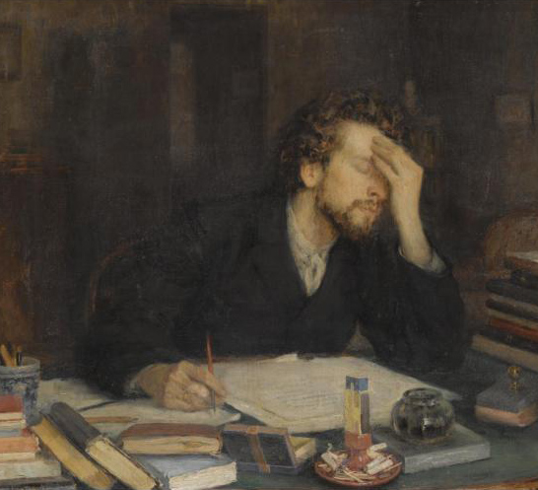
Writing an Effective Research Paper
Dr. Leigh Anne Allwood Newhook
Associate Professor of Pediatrics
Memorial University
This Photo by Unknown Author is licensed under CC BY-NC-ND

Slide 2
Checklist
Choose your target journal
Choose a clear message
Achieve high quality in your writing
Respond (politely) to reviewers’ comments
Respond to editors

Slide 3
Target journal
Major categories
General medical journals
Subspecialty journals
Methodologically-oriented journals
Writing should be targeted to the journal

Slide 4
Choosing which journal
Aiming “high” (NEJM, JAMA, BMJ, Lancet) versus aiming “low”
IMPACT FACTOR
Obvious advantages to publishing in high impact journals
Disadvantage: low acceptance rate, can be time consuming if rejected
Other advantage: high quality of peer review can strengthen your manuscript
Who is your intended readership?
Open access versus traditional subscription journals
Predatory journals

Slide 5
Beginning the process
Choosing a mentor
Choosing a topic
You must be passionate about the topic
The topic must be important
Ideally: no matter what you find (i.e., confirm OR refute the hypothesis), the result is important and should be published

Slide 6
Beginning the process
What section should you start with?
Early in the process: generate tables and graphs
Later, closer to writing.
Some suggestions:
Write entire abstract first
Write persuasive introduction first
Write methods section first
Write discussion section LAST

Slide 7
Who writes what?
Generally, the first author is responsible for the majority of the writing, especially the first draft
1
Generally, the senior author is the supervisor or mentor of the first author and is last
2
The middle authors should have provided intellectual input that justifies being listed as an author
3
In the event of equal contributions, you may ask to include “Authors X and Y contributed equally”
4

Slide 8
Write in the active voice
“We wish to suggest a structure for the salt of deoxyribose nucleic acid (DNA)”

Slide 9
Introduction
Critically important: frame the research question, engage the reader
LIMIT the size. This is not a review article.
10-15% of total word count
General background
What is known, and unknown
Primary research question, study aim and design
(Matter of style: present overall results in last line)

Slide 10
Methods
Varies depending on journal type
Methodologically oriented journals will have more details
Passive voice is often used…
Read other examples from the journal to guide you

Slide 11
Results
Write in past tense, not present tense
Table 1 typically includes basic demographic characteristics
Use tables and figures to support main text
Do not repeat information in text that is contained in tables and figures (can highlight major points)
Avoid “remarkingly” and “strikingly”
Avoid interpreting significance (save for discussion)

Slide 12
Discussion
Most challenging section to write
First sentence: reiterate the major findings
Then, place results into context, citing previous literature
Focus on mechanisms of disease
Explicitly discuss limitations
Do not hide
You must be your own toughest critic
Last few sentences are critical: highlight importance, clinical relevance, future directions

Slide 13
Submitting your paper
Cover letter
Especially when submitting to higher tier journal, explain why your findings deserve to be published
“We expect our findings to be of substantial interest to internists, intensivists, and surgeons…”
Adhere exactly to journal style
Do not use JAMA format citations when submitting to NEJM
Some journals will ask for preferred and nonpreferred reviewers

Slide 14
What happens afterwards
Editor or associate editor reviews manuscript
Decision is made whether to send out for peer review
Rejection without review
Rejection after review
Accept with major modifications
Accept with minor modifications (“We would be willing to reconsider your manuscript if you successfully respond to the…”

Slide 15
Response Letter
You’ve been invited to resubmit after a major or minor revision
You don’t agree with one of the Reviewers at all: he or she misunderstood the paper; doesn’t know the literature; has no clue what they are talking about.
In the response letter, you should do which one of the following?
A. Criticize the reviewer and point out their mistakes
B. Ignore the reviewer’s comments and focus on the other reviewers
C. Be polite but state clearly your objection

Slide 16
Should you appeal rejection?
Generally, no
Sometimes, yes
Shockingly, it sometimes works, but use sparingly

Slide 17
Take home points
Writing well is something we all continually strive for
Choose a topic that matters to you and a mentor who cares for you
The idea for the paper ideally should be interesting and publishable no matter the result
Make the Introduction succinct: it’s your opportunity to interest the reader to continue reading carefully
Limit the use of the passive voice
Make good use of Tables and Figures, and do blindly not echo those results in the Results section
Discussion section is your opportunity to put your results into context. Know the literature well. Your reviewers probably will.
Draft a short and compelling cover letter
If you are asked to suggest reviewers, consider doing so – but discuss with your mentor first
Most papers are not accepted on the first round, so you will most often have to resubmit
The resubmission letter should contain all the Reviewers’ points and your response. Feel free to copy text from your manuscript that was changed.

Slide 18
True or False
The senior author of a scientific manuscript is traditionally responsible for writing the first draft.
The Introduction sentence of a scientific paper should provide a detailed review of other scientific evidence that supports and refutes the main findings of the paper.
In the results section, write in the PAST tense rather than the present tense.
The majority of published manuscripts at major medical journals were accepted on the first round by the reviewers without the need for revisions
An editorial decision asking for “Major revisions” is a guarantee that a paper will be published if all suggestions and comments are successfully addressed in the next draft

