Slide 1
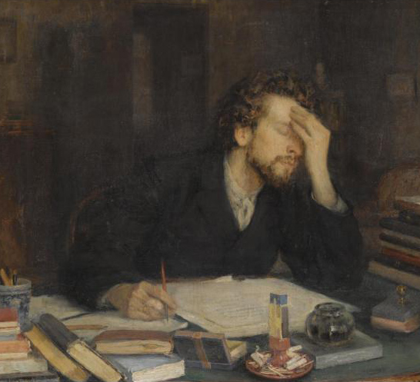
Writing an Effective Grant Application
Dr. Leigh Anne Allwood Newhook
Associate Professor of Pediatrics
Memorial University
This Photo by Unknown Author is licensed under CC BY-NC-ND

Slide 2
overview
Tips on writing clearly and effectively
Grant writing
Examples

Slide 3
importance
Writing well (and often) is one of the most important skills in research
1
Writing well takes practice
2
We all struggle with the challenge of writing clearly and effectively
3

Slide 4
checklist
Ask the right question
Know the granting agency
Collaboration
Peer-review and advice
Proposal should be well presented
Discuss your prior work (if possible)

Slide 5
beginning the process
Choose a mentor/supervisor
Choose a topic
That you are passionate about
Important to patients/health care
Ideally no matter what your results are (positive or negative) it is important to publish

Slide 6
types of grants
Government (CIHR, NSERC)
Industry (investigator initiated)
Foundations (Charities, Hospitals)
University
Career development
Seed Funding
Team Development Funding
Bridge Funding

Slide 7
grant writing
Emphasis varies depending on type of grant
career development: training plan, probability of future success
Larger grants: past work, preliminary data, feasibility, research strategy
Investigator Industry: needs to have benefits to the company’s objectives

Slide 8
grant writing
Format and emphasis may vary but the following are the same:
Clarity in writing
Strong hypotheses
Carefully considered research plan
Discussion of expected result, limitations, potential problems, alternate strategies
Single page summary of SPECIFIC AIMS

Slide 9
writing tips
PASSIVE VOICE
patients were asked to provide
measurements of ferritin were made in duplicate
ACTIVE VOICE
patients provided…
we measured ferritin in duplicate

Slide 10
writing tips
Sentences should be short and contain one point
1
Paragraphs should contain one theme and as few sentences as possible
2
Use as few words as possible
3
KISS

Slide 11
preparing the grant
Review the agency's website, annual report
contact program officer
Review what was previously awarded
Most often the reviewer is NOT an expert in the field therefore write clearly so a non-expert can understand your reasoning
Usually volunteers, over-committed, over-worked

Slide 12
specific aims
Most grants require a short summary
Spend ++++ time on this section as it is the most important part of the application

Slide 13
details matter
Read instructions carefully
Sometimes minor mistakes are why a grant is rejected
CV in draft
Wrong font/size
Deadline
Page/word limits
Make it easy on the eyes
White space (no crowding)
Use figures and tables
Judicious use of bold, underline, italics
This Photo by Unknown Author is licensed under CC BY-NC-SA

Slide 14
review criteria
Significance
Is it an important problem?
Innovation
Is it new and unique?
Investigators
Are they suited to do this?
Approach
Is there scientific merit to the strategy?
Environment
Are there institutional resources?

Slide 15
research strategy (for clinical research) make sure to address:
Study population
Exposure (or treatment)
Outcomes
Covariates:
secondary variables that can affect the relationship between the dependent variable and other independent variables of primary interest
Methods of obtaining data
Statistic approach, sample size, power
Expected findings, interpretation
Limitations, challenges, solutions

Slide 16
review
Spend a lot of time on the AIMS section
Write clearly and ask peers to review
Pay attention to specific instructions
Make grant easy to read and pleasing to the eye
Questions?

