Slide 1
What is Qualitative Research?
Roger Chafe (PhD)
Associate Professor (Pediatrics)
Memorial University of Newfoundland
July 5, 2019

Slide 2
Objectives
Discuss the question: “What is qualitative research?”
Introduce some of concepts related to qualitative research
Explore the potential application of applied qualitative health research

Slide 3
Case: Improving Patient Care - Supracondylar Humerus Fractures

Slide 4
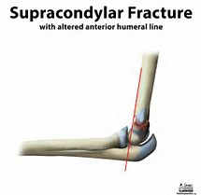

Slide 5
How do you reduce the pain of a fracture?
By immobilizing it.
Pain medications.

Slide 6
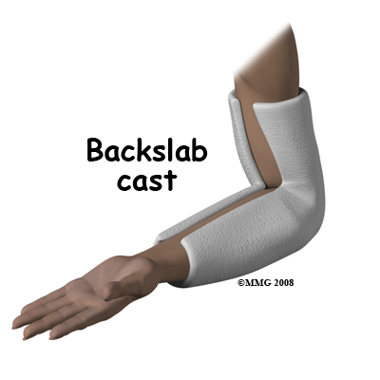
Backslab Cast

Slide 7
Research Question
How quickly are we giving pain medication and immobilizing fractures at the Janeway Emergency Department?

Slide 8
Study 1: Findings
Only 3% of patients with non-sever and 11% sever received an analgesic with 30 minutes of being in the emergency department.
Only 16% and 61% received a backslab application before X-ray in the non-severe and severe groups respectively.

Slide 9
We have a problem,
but what should we do?

Slide 10
We tried…
Mandatory pain scoring on triage;
Allowing triage nurses to treat mild to moderate pain without a physician’s order;
Educational material aimed at house staff rotating through the ED;
and posters for staff in the ED.

Slide 11
Study 2
The proportion of patients treated within 60 minutes from triage increased from 15% to 54% after the intervention.
Median time to administration of analgesic decreased from 72.5 to 11 minutes.

Slide 12
Study 2
Only 17% of cases had a documented pain score.
Rates for backslab application prior to radiography were similar before and after the interventions.

Slide 13
Things have gotten better but still not great,
so what should we do now?

Slide 14
Study 3
We wanted to find out the factors that were limiting further improvements in our treatment of pain.
Qualitative research.

Slide 15
What is qualitative research?
Defining “qualitative research” is not straight forward.
Part of the difficulty is that the term refers to a wide range of different research approaches.
These different approaches include narrative analysis, ethnography, grounded theory, phenomenology, and case study.

Slide 16
Qualitative Research Methods
Interviews
Focus Groups
Observation
Ethnography
Website Analysis
Participation Action Research
Institutional Analysis
Photo / Film Analysis
Etc…

Slide 17
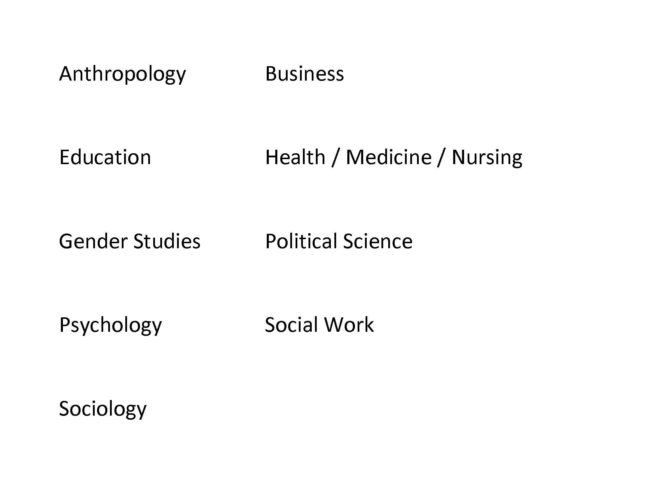
Disciplines which Use Qualitative Research

Slide 18
Disciplines that Use Qualitative Research

Slide 19
What is qualitative research?
Many qualitative research studies take a critical perspective, questioning basic social structures, even basic philosophical claims about knowledge and reality.
A good deal of qualitative research is concerned with social justice and capturing the perspective of marginalized people.
Because of these aspects, qualitative research can be methodologically dense.

Slide 20
What is qualitative research?
The problem in defining the term qualitative research is that given the broad tradition, it is hard to find characteristics that are true across all of the cases.

Slide 21
What is qualitative research?
Qualitative research deals with data that is not initially quantified in numeric or categorical form.
Qualitative research is concerned with the context in which data is collected.
Qualitative research a richer description of the events, process, people, etc. than are possible using quantitative data.

Slide 22
Qualitative research
Because of these factors, qualitative research is better suited to research a wide range of questions.

Slide 23
Types of Recent JPRU Qualitative Health Research
The experience of young mothers with accessing support services on the Avalon Peninsula
Examining the barriers adolescents and young adults have with diabetes self-management
Examining how the transition to adult care happens across NL for patients with diabetes
Determining how regional health authorities in different provinces make funding decisions

Slide 24
Qualitative and Quantitative Research
Qualitative and quantitative methods are two different sets of tools designed to address different types of research questions.
Neither is preferable.
They are also not opposed to each other, with many projects requiring the use of both sets of approaches.

Slide 25
Qualitative and Quantitative Research
Quantitative research aims towards reliability (i.e., repeatable results)
Qualitative research aims towards validity (i.e., a true description of the situation)

Slide 26
Qualitative and Quantitative Research
In qualitative research, the researcher is involved in the data collection and analysis.
Blinding is impossible;
It is recognized that the researcher will influence the collection and interpretation of data.
It is important to situate yourself vis-a-vis the research; and try to avoid unrecognized bias and preconceived interpretations.

Slide 27
Parts of qualitative research project
Identify a topic
Conduct a literature review
Formulate a main research question (or not)
Develop data collection instruments (or not)
Identify and contact study subjects
Collect data
Transcribe data
Conduct initial analysis of data / reconsider research question
Analyze (i.e., code) data
Formulate findings / Analyze Codes
Write Report

Slide 28
Key Terms: Paradigms
Paradigm: “the basic belief system or worldview that guides the investigator, not only in choices of method but in ontological and epistemologically fundamental ways.”(Guba & Lincoln, 1994)

Slide 29
Key terms: Induction
Induction: “process of moving from observations/data towards generalisations, hypotheses, or theory” – Pope and Mays

Slide 30
Key Terms: Data Saturation
Data Saturation: “The continuation of sampling and data collection until no new conceptual insights are generated.” – Bloor and Wood

Slide 31
Transcription
“Transcription is a technical typing procedure for representing spoken discourse in text.” – Bloor and Woods

Slide 32
Analyzing the data - coding
“A code in qualitative inquiry is most often a word or short phrase that symbolically assigns a summative, salient, essence-capturing, and/or evocative attribute for a portion of language-based or visual data.”
Saldana J. The Coding Manual for Qualitative Researchers, 2009.

Slide 33
Analyzing the data - Coding
Codes help analyze and organizes the data.
Codes can be developed either deductively (a priori) or inductively (a posteriori).
There is software to assist in qualitative analysis, e.g., NIVO 10.
It is important to define key codes, especially if using multiple coders.

Slide 34
Coding
“I know we kind of think of St. John’s as fairly safe, but things happen. Especially if you are quite drunk. You think nothing of just marching home, which is very nice. I mean if anything was to happen, you would be in no shape to do anything. (Pause) And there are more serious things. We know, I know someone who was drugged recently. And there is that, and that is something I don’t really think about much. But it happened and that is really scary. There are some sever things that can happen.”

Slide 35
Coding
“I know we kind of think of St. John’s as fairly safe, but things happen. Especially if you are quite drunk. You think nothing of just marching home by yourself, which is very nice. I mean if anything was to happen, you would be in no shape to do anything. (Pause) And there are more serious things. We know, I know someone who was drugged recently. And there is that, and that is something I don’t really think about much. But it happened and that is really scary. There are some sever things that can happen.”
Concern about safety

Slide 36
Coding
“I know we kind of think of St. John’s as fairly safe, but things happen. Especially if you are quite drunk. You think nothing of just marching home by yourself, which is very nice. I mean if anything was to happen, you would be in no shape to do anything. (Pause) And there are more serious things. We know, I know someone who was drugged recently. And there is that, and that is something I don’t really think about much. But it happened and that is really scary. There are some sever things that can happen.”
Concern about safety
Not overly concerned about possible threats
Not overly concerned about possible threats
Concern about safety

Slide 37
Coding
“I know we kind of think of St. John’s as fairly safe, but things happen. Especially if you are quite drunk. You think nothing of just marching home by yourself, which is very nice. I mean if anything was to happen, you would be in no shape to do anything. (Pause) And there are more serious things. We know, I know someone who was drugged recently. And there is that, and that is something I don’t really think about much. But it happened and that is really scary. There are some sever things that can happen.”
Concern about safety
Not overly concerned about possible threats
Not overly concerned about possible threats
Concern about safety

Slide 38
Coding
“I know we kind of think of St. John’s as fairly safe, but things happen. Especially if you are quite drunk. You think nothing of just marching home by yourself, which is very nice. I mean if anything was to happen, you would be in no shape to do anything. (Pause) And there are more serious things. We know, I know someone who was drugged recently. And there is that, and that is something I don’t really think about much. But it happened and that is really scary. There are some sever things that can happen.”
Risky Behaviour
Risky Behaviour
Threat
Threat

Slide 39
Assessing Qualitative Research
Does the article have a clear focus?
Was an appropriate method used and conducted appropriately?
Who were the study subjects and were they the best people to involve for answering the question?
Is there sufficient detail given about how data was collected and analyzed?

Slide 40
Assessing Qualitative Research
How did the researcher position him or herself and try to control for bias?
Are the conclusions reached by the researcher reasonable and supported by the data?
Are limitations clearly stated?

Slide 41
Study 3: Supracondylar Humerus Fractures
We interviewed nursing and physician staff within the ED.
We surveyed patients, including using open ended questions.
We held focus groups with most of nursing staff within the ED.

Slide 42
Study 3: Supracondylar Humerus Fractures
Barriers:
Difficulties in accurately capturing the level of pain with the current pain assessment tools.
Issues in treating specific types of patients.
Current initiatives did not address treatment of patients with severe pain.
Staff comfort with initiatives.

Slide 43
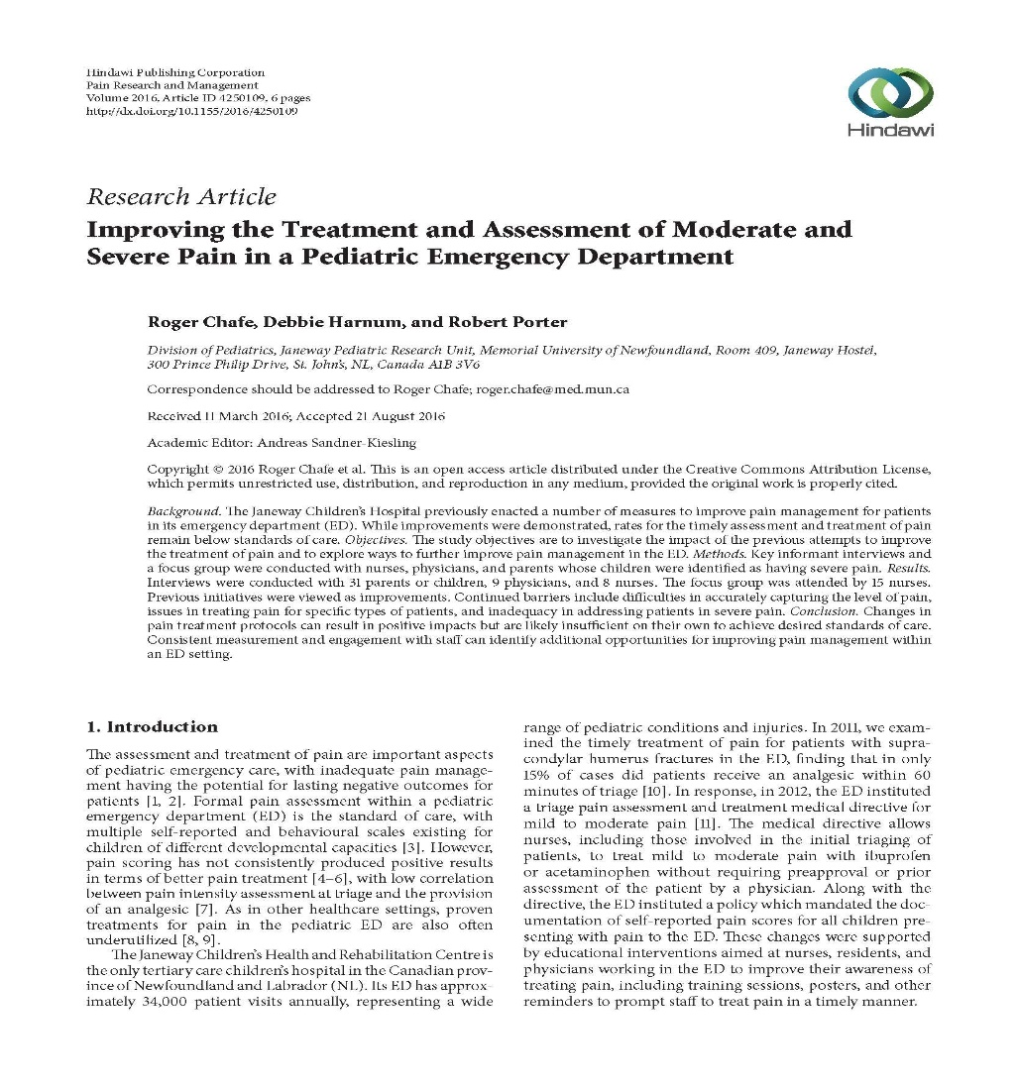
In 2016…

Slide 44
Currently…
We are looking at how pediatric fractures are being managed across the province.

Slide 45
Conclusion
Qualitative research can seem confusing at first, but it is a valuable approach for addressing many important questions for health research.
It can be very engaging, and many researchers find it quite rewarding form of research.
Don’t let the methodological complexity of qualitative research put you off, because it does not need to be more methodologically complex than other forms of research.

Slide 46
Recommendation

Slide 47
References
Bloor M, Wood F. Keywords in Qualitative Methods. Sage, 2006.
Greenhalgh T. “How to read a paper: Papers that go beyond numbers (qualitative research)” BMJ 1997: 315: 740.
Guba, E. G., & Lincoln, Y. S. (1994). Competing paradigms in qualitative research. Handbook of Qualitative Research, 2(163-194).
Pope C, Mays N. Qualitative Research: Reaching the parts other methods cannot reach: an introduction to qualitative methods in health and health services research; BMJ 1995, 311:42.

