Slide 1
Doing research in the Pediatric ED

Slide 2
Pediatric Emergency Departments
15 in Canada
Academic centres
Pediatric Emergency Research Canada (PERC)
Translating Emergency Knowledge for Kids (TREKK)
Local scene
Janeway is one of the smaller Ped EDs
36,000 patients yearly
14 staff physicians (single or double coverage)
~180 learners per year

Slide 3
Types of research you can do in the Peds ED
Case study
Chart reviews
Observational cohort study
Surveys
Quality research
Database study
Single-site or multi-site (PERC network)

Slide 4
You can ask questions about:
Diagnosis
Treatment
Patient disposition
Patient flow
Effect of quality interventions
Physicians who work in the ED
Discharge instructions

Slide 5
You can pick a population of patients:
Age-group
Specific medical condition
Non-English speaking
New immigrants/refugees
Utilization of a specific resource
LWBS (left without being seen) patients
Patients who come after midnight

Slide 6
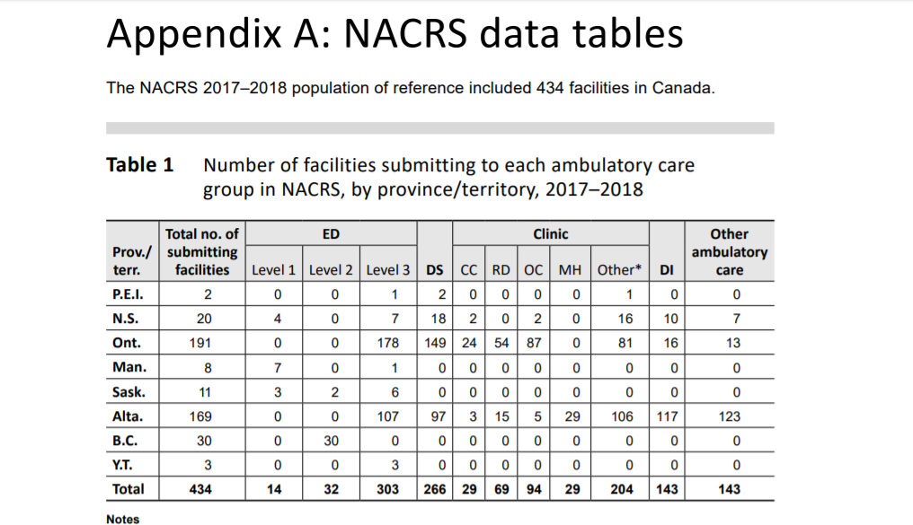
Opportunities and challenges
Chart reviews
Lots of patients
Lack of coding (chief complaint, CEDIS complaint, times, demographics)
DC dx NOT coded
No electronic medical record

Slide 7
Opportunities and challenges
Recruiting patients
Lots of them especially with common conditions
Fast-paced environment
Obtaining consent
Cannot delay care
Multiple providers
MH patients

Slide 8
Strategies for successful research in ED
Research question informed by plausibility of sample identification
No sample = no answer
Be creative in collecting your sample
Get to know the people who have data (medical records, PACS, lab etc.)
How to identify sample
PACS
Log sheets/lists
Track something prospectively
Don’t forget staff (MDs, nurses, allied health)
Use available networks (PERC, TREKK)

Slide 9
Illustrative examples of local PED research

Slide 10
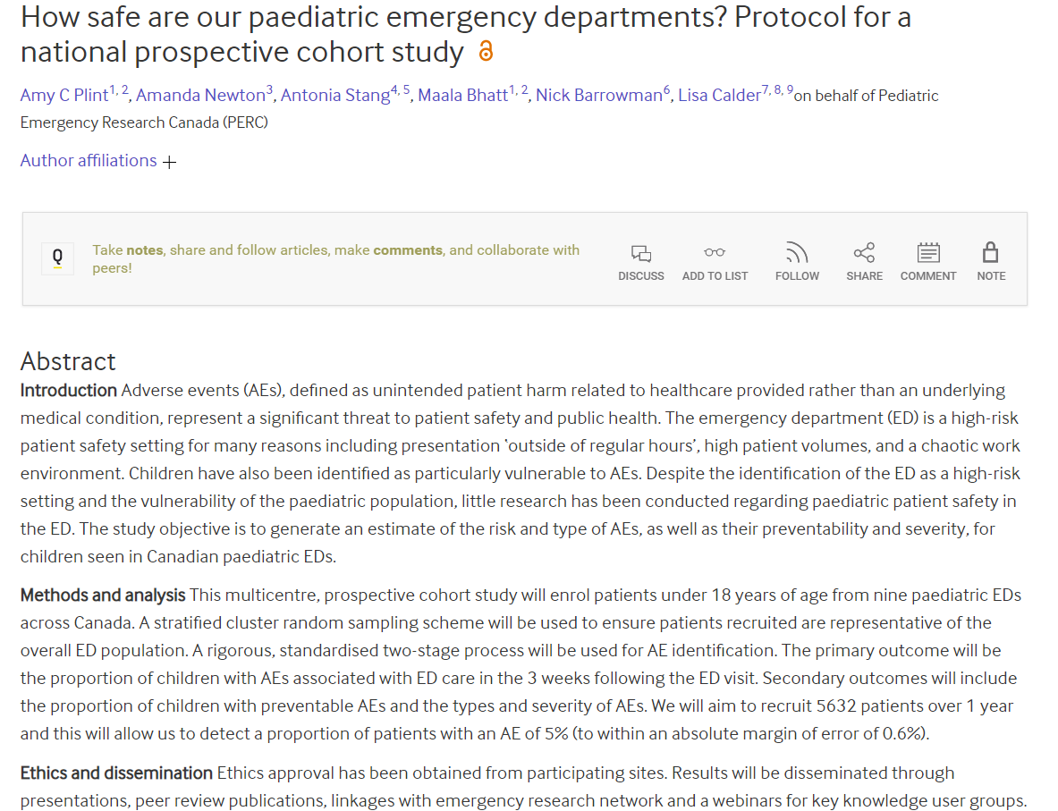

Slide 11
How safe are our pediatric EDs: a multicentre prospective cohort study
Research Assistants (RAs) were present in the ED for each randomized shift, and aimed to enroll consecutive patients presenting to the ED.
A research nurse attempted to contact all patients (and/or their parents) by telephone at 7, 14, and 21 days following their visit to administer a structured interview and identify patients with flagged outcomes.
21 randomized shifts
9 pediatric EDS
Nationally 6377 (72%) of 8855 eligible patients

Slide 13
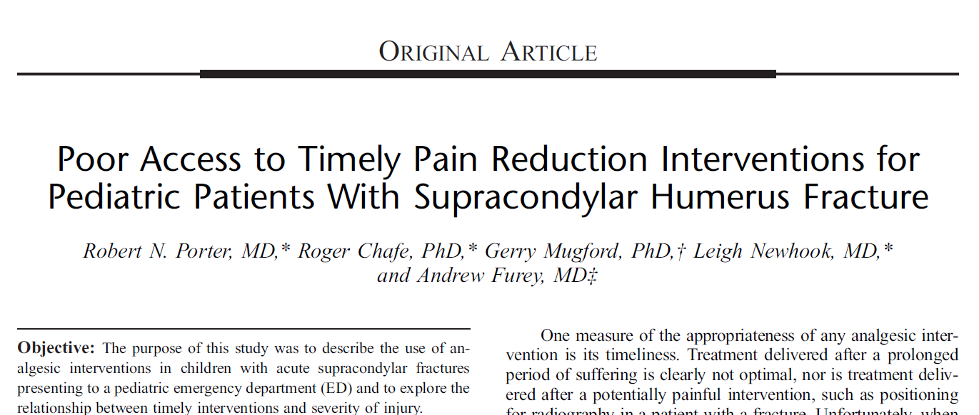

Slide 15
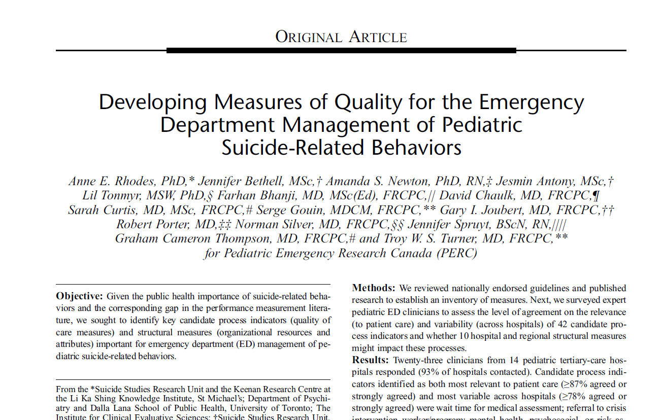

Slide 16
