Slide 1
QIPS part 1
Research Summer Series
Aug 2019

Slide 2
outline
Introduction to QIPS
Basics of safety culture
Root cause analysis
Systems versus Individual
Case study
Summary

Slide 3
Introduction to QIPS
https://www.youtube.com/watch?v=jq52ZjMzqyI

Slide 4
What defines Quality Health Care?
Safe: Care should not harm the patients it is intended to help.
Effective: Care should be evidence-based.
Person-centred: Care should be respectful, responsive and aligned to patient values and needs.
Timely: Care should be given at the right time, and minimize delays.
Efficient: Care should minimize waste and be cost-effective.
Equitable: Equal quality care for all.

Slide 5
Culture (n):
the beliefs, customs, arts, etc., of a particular society, group, place, or time

Slide 6
Culture of safety and quality
Error reporting :
responsibility vs. weapon
Investigation of events:
opportunity to improve vs. reason to punish
Is the focus of discussion:
system vs. individual

Slide 7
Culture of safety and quality
Culture drives safe care delivery
Culture is about behaviors
Domains of behaviors include:
Teamwork communication
Professionalism
Response to errors

Slide 9
Culture in the Learning Environment
Beyond the written or spoken beliefs about quality or safety
Is there a Hidden Curriculum?
Are there unspoken, unofficial set of beliefs that govern behavior in the clinical setting
What is the culture in the practice environment?
Why is it important?
second victim

Slide 10
Disruptive behaviors
Verbal or physical threats
Reluctance/refusal to answer questions,
Refusal to answer pages or calls
Impatience with questions
Condescending language or intonation

Slide 11
In in next few minutes….
What does the culture/ learning environment look like at our institution?
What is the view of the students?
Do you see faculty engaging in positive learning culture activities?
How do you think you be treated if there was a difficult situation that you were involved in (such as a privacy breach)?

Slide 12
Quality Improvement: Systems can be made safer by design
Research and experience outside of health care have shown us that complex systems can be made safer by design [Nolan 2000, Reason 2000]

Slide 13
Definitions
Error - An act of commission (doing something wrong) or omission (failing to do the right thing) that leads to an undesirable outcome or significant potential for such an outcome
e.g. known penicillin allergic patient receives penicillin and has anaphyllaxis
Adverse Event - Any injury caused by medical care. Identifying something as an adverse event does not imply "error," "negligence," or poor quality care. It simply indicates that an undesirable clinical outcome resulted from some aspect of diagnosis or therapy, not an underlying disease process.
e.g. patient’s IV infiltrates
Near Miss - An event or situation that did not produce patient injury, but only because of chance. This good fortune might reflect robustness of the patient or a fortuitous, timely intervention This definition is identical to that for close call.
e.g. a patient with penicillin allergy receives penicillin, but has no reaction
e.g. a nurse happens to realize that a physician wrote an order in the wrong chart

Slide 14
Root cause analysis (RCA)
a systematic review of an event to determine the fundamental deficiencies (contributing factors) that lead to the incident or near miss
The term “root cause analysis” is misleading
Implies that one “root cause” is responsible for adverse events
There are almost always multiple contributing factors, no one of which alone is the root cause
“Contributing factors analysis” or “systems analysis” might be better terms

Slide 15
RCA should be both Systematic and Comprehensive
Focus should be broader/deeper than obvious or proximate causes
Example: natural inclination to stop an investigation of a medication error after discovering that one nurse did not read a medication label carefully
RCA process forces one to examine all levels of an organization—not just a single health care provider’s behavior
Scrutinize important factors such as management decisions, staffing policies, equipment design, etc.

Slide 16
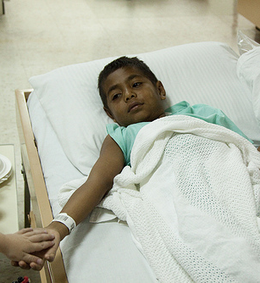
Case Example: Johnnie
A 5 year old boy undergoes a planned nephrectomy for Wilms Tumor
Intraoperative Course is uncomplicated
Patient awakens in the Post Anesthesia Care Unit and mother asks nurses why his left side is bandaged when he was supposed to have undergone right nephrectomy

Slide 17
What is your first reaction?
Consider 2 alternatives
Is there someone to blame?
Can we approach this with non-punitive learning?

Slide 18
Root Cause Analysis video
https://www.youtube.com/watch?v=nAjlLr-5sy0

Slide 19
The Root Cause Analysis
You are assigned the task of investigating the adverse event and reducing the risk of future, similar events
You gather the staff involved to discuss the facts and timeline to begin to grasp the situation
You gather the facts and construct this timeline

Slide 20
Systematic Why Why Why???
Ask a series of “WHY” questions:
WHY did the nurse do….?
WHY did the surgeon use….?
WHY did the nurse ask for ?
WHY did the trainee…..?
Counter the tendency to focus on the obvious causes proximate to the adverse event
Gather information from a variety of sources
Address factors at all levels of an organization
Ensure that broader (and often more important) systemic factors receive adequate scrutiny
Draw a RCA causal map and/or fishbone map

Slide 21
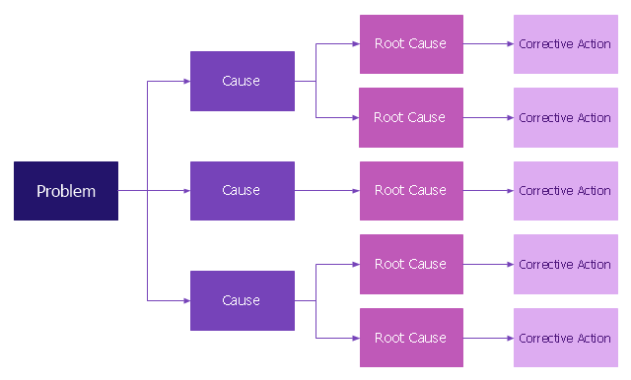
RCA Causal Map

Slide 22
Root Cause Analysis Map (fishbone diagram)

Slide 23
Examine Contributing Factors
No single root cause
Rather, a complex web of causes
Easy and natural for us to focus on the “active failures” or actions that directly caused an adverse event
However, other factors make the active failures more likely to occur and are Less obvious, perhaps, but even more important

Slide 24
Human Errors
Skill Based
Usually happens when a familiar, automatic procedure/task is being performed.
Not much conscious action.
May happen when the situation falls out of routine (driving a car)
Rule Based
When a familiar pattern is not being recognized, a shortcut, not recalling the rule appropriately
Knowledge Based
When a situation is unique or unknown, for which no rules exist and intelligent problem solving is required

Slide 25
Contributing Factors
Institutional
Regulatory context
Medico-legal environment
Organization and management
Financial resources, constraints
Policy standards and goals
Safety culture and priorities
Work environment
Staffing levels and mix of skills
Patterns in workload and shift
Design, availability, and maintenance of equipment
Administrative, managerial support
Team
Oral, written communication
Supervision and willingness to seek help
Team leadership
Individual staff member
Knowledge and skills
Motivation and attitude
Physical and mental health
Task
Availability and use of protocols
Availability and accuracy of data
Patient
Severity of illness
Language and communication
Personality and social factors

Slide 26
Corrective Action Planning ….a hierarchy for remedial actions based on decreasing effectiveness
1. Fix environmental problems
2. Forcing functions and constraints
3. Automation and computerization
4. Protocols, standards and information
5. Independent verification and redundancy
6. Rules and Policies
7. Education and information

Slide 27
RCA Summary
Systematic and thorough search for contributing factors
Forces one to look beyond the obvious
Goal is improvement
Focus is learning, not blaming
Supports the second victim
Leads to effective change

Slide 28
What we discussed
Introduction to QIPS
Basics of safety culture
Definitions: error, adverse event, near miss
Root cause analysis
Systems versus Individual
Human error
Contributing factors

