Slide 1
QIPS part 2
Summer series
2019

Slide 2
What we discussed in part 1
Introduction to QIPS
Basics of safety culture
Definitions: error, adverse event, near miss
Root cause analysis
Systems versus Individual
Human error
Contributing factors
Case study

Slide 3
Outline part 2
Frontline Improvement
Safe patient handover (Dr. Jennifer O’Dea)
Patient Safety and Incident Reporting

Slide 4
Quality Improvement: Systems can be made safer by design
Research and experience outside of health care have shown us that complex systems can be made safer by design [Nolan 2000, Reason 2000]

Slide 5
Frontline Process Improvement: any systematic program to improve organizational routines with the goal of improving outcomes, improving safety, improving efficiency

Slide 6
Frontline PI-Project selection
How to choose which QI project to undertake?
Early on, consider:
Burning platform
Local buy-in
Resources

Slide 7
How do I prioritize PI projects?
Cost
Low cost, high impact
Project
Choose specific aim
Assemble your team
Commit to a timeline

Slide 8
Frontline PI: Metrics
How will you know your aim has been met?
Meaningful quality metric
Time
Money
Harm
Patient/family satisfaction
Ex. “We would like to reduce labeling error by 10% over the next 12 months.”
How will you track your metrics?
Statistical Process Control
Visual data presentation
Understanding of process variation, reliability

Slide 10
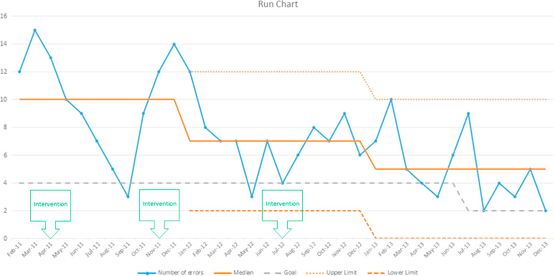

Slide 11
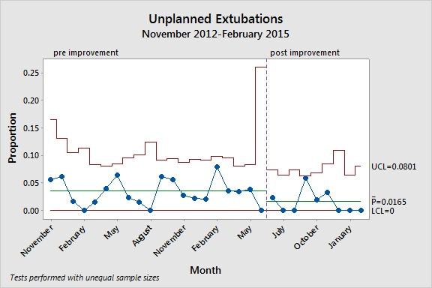

Slide 12
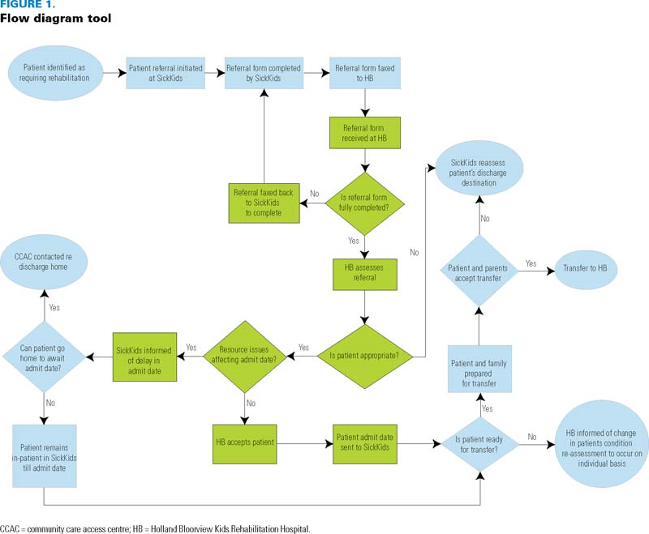
Frontline PI: Implementation
Map the process
Use frontline staff

Slide 13
Frontline PI: Implementation
Once you’ve picked an innovation, you must test it out
And try again!
PDSA cycles
Plan
Do
Study
Act

Slide 14
Frontline PI: People
Need Buy-in
Early adopters
laggards, in between
Cognitive biases
Heuristics
is any approach to problem solving, learning, or discovery that employs a practical method, not guaranteed to be optimal, perfect
Make it easy
How is it a win from their perspective?

Slide 15
Frontline PI: Failure/Success
Failure is a part of innovation
Manage expectations early
Learning from failure is a trait of High Reliability Organizations and Successful Leaders

Slide 16
Planning a frontline improvement project: overview
Select Project
Choose specific aim and commit to a timeline
“We would like to reduce labeling error by 50% over 2 years”
Assemble your team
frontline + leadership
Metrics
How will you track your metrics?
Statistical Process Control
Visual data presentation
Understanding of process variation, reliability
Implementation
Once you’ve picked an innovation, you must test it out.
And try again!
PDSA cycles
Plan
Do
Study
Act
People
Health care workers
leadership
Patients and families
Anticipate what Failure/Success looks like

Slide 17
Take Home Messages
A successful QI project requires detailed planning and human investment
When successful, it is exceptionally rewarding and can lead to widespread culture change

Slide 18
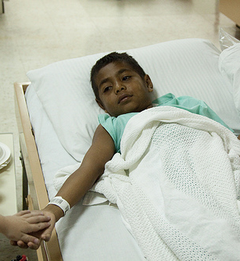
Case Example: Johnnie
A 5 year old boy undergoes a planned nephrectomy for Wilms Tumor
Intraoperative Course is uncomplicated
Patient awakens in the Post Anesthesia Care Unit and mother asks nurses why his left side is bandaged when he was supposed to have undergone right nephrectomy

Slide 19
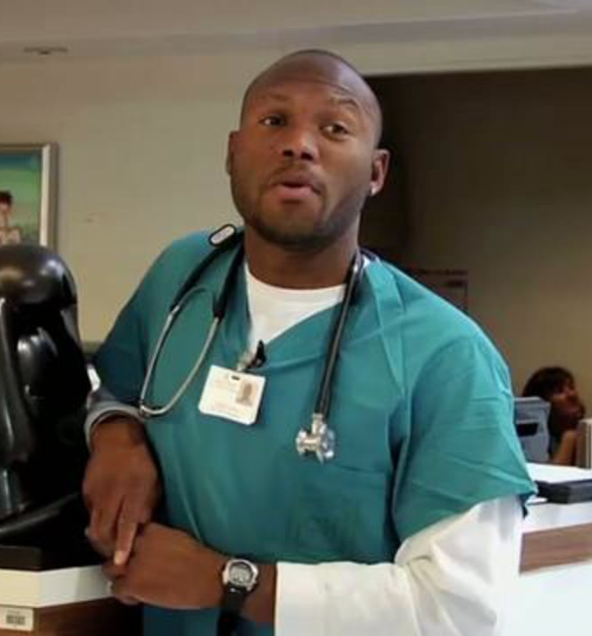
Interview with the Nurse
Patient wheeled into the room prior to the room being ready
First day for a new trainee physician who could not find his lead apron so he needed to leave room to help him
Can’t recall the time out, but believes that someone did it quickly in the room. Does remember documenting time out
Feels awful. Didn’t sleep last night
Tears well up in the nurse’s eyes
This Photo by Unknown Author is licensed under CC BY

Slide 20
Surgeon Interview
Could not find a marking pen so used a ball point pen to mark flank in the holding area. Marked the left flank
Helped wheel the patient into the room prior to the room being ready
Frustrated that the nurses were not ready she had to do some of the set up herself
Was anxious about this case as it was a rare procedure
Placed the blanket roll herself as was her preference – but cannot recall why she placed it on the wrong side
New CHG cleanser tends to wipe off pen mark so was not surprised not to see a mark once resident prepped surgical site
Can’t recall the time out, but believes that someone did it quickly in the room
Feels awful

Slide 21
Physician Trainee Interview
First day on service for him and first pediatric surgical rotation
No orientation to this operating room
Could not find his lead apron
Can’t recall the time out, but believes that someone may have done it quickly in the room
Is worried about the evaluation that his attending will give him
Feels terrible about the patient

Slide 22
Anesthesiologist Interview
Once the patient was put to sleep, she did not notice that the prep was proceeding on the wrong side
Believes it is the surgeon responsibility to know what side and site is being operated on
Can’t recall the time out, but believes that someone did it quickly in the room
Is angry at hospital administration as OR staffing has been reduced and safety is compromised

Slide 23
OR Nurse Leader Interview
Everyone knows that a time-out should be done
Audits of documentation have demonstrated 100% compliance with the time outs
Everyone knows that ball point pen should not be used to mark sites
It is the responsibility of the surgeons to orient the trainees when they are new to the OR
Is worried about her staff

Slide 24
The Surgical Case
Human Factors
Slip – placement of blanket under wrong side by surgeon
Qualification – trainee with no OR experience
Coordination – time out not performed as everyone thought someone else did it
Verification – of the side/site prior to scalpel use
Technical Factors
Materials – ball point pen use
Organizational Factors
Transfer of knowledge – trainee with no knowledge of time out process
Protocols – time out process not highly specified
Management priorities
rushed for on time start
Culture
general lack of reverence for time out process

