Slide 1
Introduction to Study Design
Rosie Stanoev, Master’s Student (Clinical Epidemiology)

Slide 2
Basic Principles of Study Design
Study design is chosen based on the research question
Calculation of a sample size
Classification of a sample of the population into study groups
Selection of outcome measures
Protocols, definitions, inclusion/exclusion criteria should be established before the study begins

Slide 3
Levels of Evidence ⁽¹⁾

Slide 4
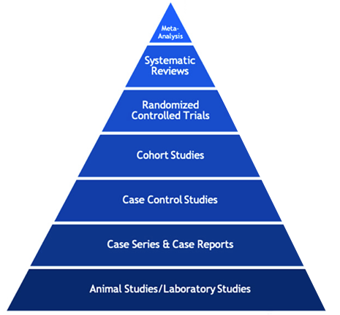
Case Reports and Series
Case Report
A detailed report of the diagnosis, treatment, and follow-up of an individual patient ⁽²⁾
Often describes a novel or unusual case
Case Series
A group of case reports of patients with a similar treatment or condition ⁽³⁾

Slide 5
Case Reports and Series

Slide 6
Observational Studies
Researchers examine relationships between exposures and outcomes without attempting to change the outcome ⁽⁵⁾
Observational

Slide 7
Case-Control Study
Case: Study participant with the disease or condition of interest ⁽⁶⁾
Control: Study participants without the disease or condition of interest ⁽⁶⁾

Slide 8
Case-Control Study
Advantages
Can be used to study rare diseases
Can be conducted quickly
Disadvantages
Subject to many biases: temporal, researcher, recall

Slide 9
Case-Control Study
Population | Children
Cases | Burn injury
Controls | No burn injury

Slide 10
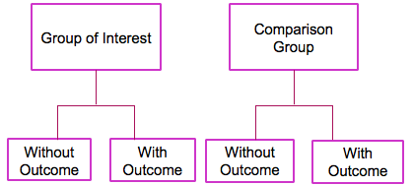
Cohort Study
Participant outcomes are compared based on an exposure to a certain risk factor ⁽⁹⁾
Retrospective
Prospective
Time
Time
Note: The star indicates start of research

Slide 11
Cohort Study
Advantages
Exposure is measured before outcome
Can study multiple outcomes
Disadvantages
Changes in exposure status may occur
May require long follow-up

Slide 12
Cohort Study
Population | Mothers and their children
Exposure/Risk Factor | Pre-pregnancy obesity
Comparison | No pre-pregnancy obesity
Outcome | Childhood malignancies

Slide 13
Experimental Studies
Experimental
Researchers test how an intervention of their choice impacts certain participant outcomes

Slide 14
Randomized Controlled Trial
Many types of RCT design: parallel, crossover, factorial
Randomization
Intervention types: therapy, prevention, diagnosis
Four potential levels of blinding: participant, outcome assessor, researcher, allocation of treatment

Slide 15
Randomized Controlled Trial
Population | Overweight adolescents
Intervention | CBT
Comparison | Treatment as usual
Outcome | Diet, anthropometrics, QoL

Slide 16
Factors to Consider
When designing a study, you may want to consider:
Research Question
Research Team
Feasibility
Ethics

Slide 17
Levels of Evidence ⁽¹⁾

Slide 18
References
1. Georgetown University Medical Center. Type of Clinical Question and Study Design [Internet]. 2020. Available from: https://guides.dml.georgetown.edu/ebm/ebmclinicalquestions
2. National Cancer Institute. Case Report [Internet]. National Cancer Institute. 2011 [cited 2020 May 7]. Available from: https://www.cancer.gov/publications/dictionaries/cancer-terms
3. National Cancer Institute. Case Series [Internet]. National Cancer Institute. 2011 [cited 2020 May 7]. Available from: https://www.cancer.gov/publications/dictionaries/cancer-terms
4. Friede RL. Subpial Hemorrhage in Infants. J Neuropathol Exp Neurol. 1972 Jul 1;31(3):548–56.
5. National Cancer Institute. Observational Study [Internet]. National Cancer Institute. 2011 [cited 2020 May 7]. Available from: https://www.cancer.gov/publications/dictionaries/cancer-terms
6. National Cancer Institute. Case-Control Study [Internet]. National Cancer Institute. 2011 [cited 2020 May 7]. Available from: https://www.cancer.gov/publications/dictionaries/cancer-terms
7. Audigé L, Ayeni O, Bhandari M, Boyle B, Briggs K, Chan K, et al. A Practical Guide to Research: Design, Execution, and Publication. Arthrosc J Arthrosc Relat Surg Off Publ Arthrosc Assoc N Am Int Arthrosc Assoc. 2011 Apr 1;27:S1-112.
8. Padalko A, Gawaziuk J, Chateau D, Sareen J, Logsetty S. Social Determinants Associated with Pediatric Burn Injury: A Population-Based, Case-Control Study. J Burn Care Res Off Publ Am Burn Assoc. 2020 Apr 18;
9. National Cancer Institute. Cohort Study [Internet]. National Cancer Institute. 2011 [cited 2020 May 7]. Available from: https://www.cancer.gov/publications/dictionaries/cancer-terms
10. Kessous R, Wainstock T, Sheiner E. Pre-pregnancy obesity and childhood malignancies: A population-based cohort study. Pediatr Blood Cancer. 2020 Jun;67(6):e28269.
11. Nair B. Clinical Trial Designs. Indian Dermatol Online J. 2019;10(2):193–201.
12. Miri SF, Javadi M, Lin C-Y, Griffiths MD, Björk M, Pakpour AH. Effectiveness of cognitive-behavioral therapy on nutrition improvement and weight of overweight and obese adolescents: A randomized controlled trial. Diabetes Metab Syndr. 2019 Jun;13(3):2190–7.

