Slide 1
Introduction to Study Design and Biostatistics
Rana Aslanova MD, PhD
JPRU, Faculty of Medicine, MUN
May 8, 2020

Slide 2
How Do I Get Started? Where to Look?
First Step:
Research Idea or Initial Problem/
Research Question/Hypothesis

Slide 3
Research idea may originate:
Consultation with supervisor or mentor
Practical clinical problems
Willingness to explore new strategies
Novel ideas arise when old problems are considered from a new perspective
Reading textbooks and articles & thinking of ways to extend or refine previous research
Scientific meetings
Granting agencies
….

Slide 4
A FINER Idea
Feasible
Interesting
Novel
Ethical
Relevant

Slide 5
Next Step:
To generate a researchable question from the general idea.
Type of RQ:
Parameter estimation for a health condition or diagnosis
Hypothesis generation
Hypothesis testing
Confirmatory study
Knowledge translation

Slide 6
PICOT Question
P-(or People, or Patients)
I-(if applicable)
C-Control (or Comparison)
O-Outcome
T-Timeframe

Slide 7
Bad RQ:
Is anticoagulation beneficial in patients with atrial fibrillation?
Right RQ:
Do patients over the age of 75 with atrial fibrillation for no longer than 48 hours who are randomly assigned to receive Coumadin have a lower 1-year risk of Embolic Cardiovascular Accident compared with those randomly assigned to receive Aspirin or Placebo?

Slide 8
Some Questions to Ask…
What specific data or information will you need to collect in order to answer your research question?
Does the data already exist somewhere or do you need to collect it directly from the patients/participants?
What collection method(s) might be necessary (e.g., chart review, surveys, interviews, patient follow-up, tests)?
How many participants/cases (sample size) might you have to include?
How difficult will it be to recruit enough participants/find enough cases to meet the required sample size?
How long might it take to collect the necessary data from this number of participants/cases?

Slide 9
Study Design

Slide 10
What is a Research Design in Research?
Study Design is not a choice but a function of matching the Research Question to the Study Design that will provide the most unbiased answers.
The purpose of a research design is to provide a plan of study that permits accurate assessment of cause and effect relationships between Risk Factor (Exposure) and Disease (Outcome) variables.
Three main purposes of research are
Describe, Explain, and Validate findings.

Slide 11
Qualitative vs. Quantitative Data
There exists a fundamental distinction between two types of data: qualitative and quantitative. The way we typically define them, we call data 'quantitative' if it is in numerical form and 'qualitative' if it is not.
Quantitative and qualitative data provide different outcomes, and are often used together to get a full picture of a population (e.g., length of disease, physical & laboratory measurements, age-quantitative data; country, occupation, ethnic background-qualitative data).
Data collected about a numeric variable will always be quantitative and data collected about a categorical variable will always be qualitative.

Slide 12
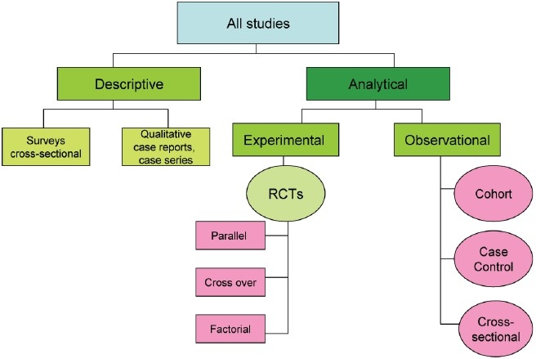
Study Design
Asiam S et al, 2012 Indian J Sex Transm Dis AIDS

Slide 13
Descriptive Research
Descriptive research methods are pretty much as they sound — they describe situations. They do not make accurate predictions, and they do not determine cause and effect. They do not answer questions about how/when/why the characteristics occurred.
The main types of descriptive methods are:
Case Reports, Case Series, Surveys, Interviews and Focus Groups.
Descriptive research does not fit neatly into the definition of either quantitative or qualitative research methodologies, but instead it can utilize elements of both, often within the same study.

Slide 14
Case Report & Case Series
They describe the experience of a single patient or a group of patients with a similar diagnosis.
The collection of a case series rather than reliance on a single case can mean the difference between formulating a useful hypothesis and merely documenting an interesting medical oddity.

Slide 15
Advantages | Disadvantages
Recognizes new diseases/conditions | Based on experience of one person, or just a few people. Researcher’s own subjective opinion may influence the case study (Researcher Bias)
Provides detailed (rich qualitative) information | The presence of any risk factor may be coincidental
Formulates hypothesis and/or provides insight for further research | Can’t generalize the results to the wider population
 | Difficult to replicate
 | Time consuming

Slide 16
Survey Types of Questions
Binary Questions (yes/no)
Likert-type Questions (-Strongly Disagree, – Disagree, – Neutral/Neither Agree nor Disagree, – Agree, – Strongly Agree)
Open-ended questions

Slide 17
Advantages | Disadvantages
The research produces data based on real-world observations (empirical data) | The significance of the data can become neglected
Data based on a representative sample, and can therefore be generalizable to a population | The data that are produced are likely to lack details or depth on the topic being investigated.
Surveys can produce a large amount of data in a short time for a fairly low cost (Time & Cost-Effective) | Securing a high response rate to a survey can be hard to control, particularly when it is carried out by post or email
 | “Self-reported data” is limited in its validity and should be interpreted cautiously (recall bias, selection bias, participant bias,…)

Slide 18
Interviews
The purpose of the research interview is to explore the views, experiences, beliefs and/or motivations of individuals on specific matters
They are also particularly appropriate for exploring sensitive topics, where participants may not want to talk about such issues in a group environment
Respondents should be informed about the study details and given assurance about ethical principles, such as anonymity and confidentiality (Implied Consent)
All interviews should be tape recorded and transcribed verbatim afterwards

Slide 19
Interviews (cont’d)
Structured interviews
Unstructured interviews
Semi-structured interviews
Quick & Easy to Administer
Allow for Limited Participant Responses
Time-consuming
Difficult to Manage
Flexible
Allows for the Discovery or Elaboration of Information

Slide 20
Interviews (cont’d)
Advantages | Disadvantages
Deep & Free Response | Costly in Time & Personnel
Flexible, Adaptable | Duration of Interview
Glimpse into Respondent’s Tone, Gesture | Require Skills
Ability to Probe, Follow-up, Clarify Misunderstandings about Questions | Maybe Difficult to Summarize Responses
Hypothesis Creating/Testing | Possible Biases: Interviewer, Respondent, Situation…
Personal (face-to-face) & Telephone

Slide 21
Focus Groups
Focus groups have advantages over individual interviews in that they allow the researcher to gather information from a group of people quickly and allow participants to discuss the questions together, deliberating on the topics [“richer data”]. However, effective use and moderation of a focus group requires some skill and experience.
Confidentiality can be an issue (Lack of Anonymity).
Key Points:
Interaction
Group Size (6-8)

Slide 22
Focus Groups (cont’d)
Some researchers suggest 2 general principles:
Questions should move from general to more specific questions
Question order should be relative to importance of issues in the research agenda.
The Interview & Focus Group scripts and process must be non-leading.
Consider the Hawthorne Effect.
Notes:
The Hawthorne Effect is a phenomenon in which individuals alter their behavior in response to being observed, and usually refers to positive changes. Workers participating in a study might, for example, temporarily become more productive as a result of being observed.

Slide 23
Random Bonobo
Only a Baby now, but maybe Researcher later?

Slide 24
Study Design
Asiam S et al, 2012 Indian J Sex Transm Dis AIDS

Slide 25
Observational Studies
There are four main types of Observational studies:
Ecological
Cross-sectional
Case-Control
Cohort
The Investigator does not control the assignment of Exposure and is only involved passively in collecting data on Exposure followed by Outcome assessments.

Slide 26
Ecological Studies
The average exposure of a population is compared with the rate of the outcome for that population.
The data is obtained for several populations and the data are examined for the evidence of an association between outcome and exposure.
The unit of analysis is the population, rather than the individual, therefore the only conclusions we can draw relate to the population.
There is no possibility to make conclusions about the association between exposure and outcome at the individual level.

Slide 27
Cross-Sectional or Prevalence Studies
A study of population at a single point in-time. They are useful for determining the Prevalence of Risk Factors & the Frequency of Prevalent Cases of a disease for a defined population. They are also useful for measuring current health status and planning for some health services.
A cross sectional study takes a snapshot of a population at a certain time, allowing conclusions about phenomena across a wide population to be drawn.
Example: Prevalence of Breast Cancer in NL Population.

Slide 28
Cross-Sectional Studies (cont’d)
In Cross-Sectional studies Inputs and Outputs are measured simultaneously and their relationship is assessed at a particular point in time.
Advantages | Disadvantages
Fairly quick and easy to perform | Can’t provide temporal relationship between Risk Factors & Disease
Useful for hypothesis generation | No good for hypotheses testing

Slide 29
Case-Control Studies
Case-control studies compare Exposures in Disease Cases vs. matched Healthy Controls from the same population.
Researchers starts by identifying participants by the presence (cases) or absence (controls)of disease and exposure is assessed retrospectively.
Outcome is measured before exposure.
Present Day
Exposure?
Controls (Disease Absent)
Exposure?
Cases (Disease Present)
Time
Unknown Mechanism of Assignment
Unknown Temporal Relationship

Slide 30
Case-Control Studies (cont’d)
Data are collected retrospectively, therefore they are relatively unreliable.
Advantages | Disadvantages
Inexpensive & less time-consuming compared to Cohort Studies | Susceptible to both Selection & Information Bias
Good for Rare Diseases with long latencies | Does not allow estimation of Risk
Allows Several Exposures to be evaluated | Does not consider more than one Disease
Matched Intervention & Control groups | Not feasible for Rare Exposures

Slide 31
Cohort Studies
A Cohort is a group of subjects, defined at a particular point in time, that shares a common experience (e.g., exposure to potential Risk Factor for a given Disease/Outcome).
Cohort studies are frequently employed to study:
The Association of RF & Development of Disease
Disease Prognosis
Cohort studies are an effective way to circumvent many of the problems that make an RCT unfeasible (harmful RFs).
Cohort studies are inherently prospective in that Outcomes can be assessed only after Exposure to the RF but can be retrospective as well.

Slide 32
Prospective vs. Retrospective Cohort Study
In a retrospective cohort study, the group of interest already has the disease/outcome. In a prospective cohort study, the group does not have the disease/outcome, although some participants usually have high risk factors.
Retrospective example: a group of 100 HIV+ people might be asked about their lifestyle choices and medical history in order to study the origins of the disease. A second group of 100 people without HIV are also studied and the two groups are compared.
Prospective example: a group of 100 people with high risk factors for HIV are followed for 20 years to see if they develop the disease. A control group of 100 people who have low risk factors are also followed for comparison.
Retrospective cohort study can be combined with a prospective cohort study: the researcher takes the retrospective study groups, and then follows the cohort in the future

Slide 33
Types of Cohort Studies
Present Day
Exposure
Outcome Measurement
Outcome
Measurement
Standard Prospective
Historical or Retrospective Cohort
Long latency period
Exposure
Ambi-
directional
Exposure
Outcome
Measurement
Time

Slide 34
Cohort Studies (cont’d)
Advantages | Disadvantages
Least prone to Bias compared to other Observational studies | Often costly
Forward directionality looks at Cause before Effect | Time-consuming particularly if prospective
Can be used to study Several Diseases | Loss-to-follow-up may lead to Bias
Studies Rare Exposures | Can be used for studying Rare Diseases but requires very large SS
Comparatively Powerful to assess relationship between RF (Exposure) & Outcome (Disease) | Selection Bias & Confounding can be a problem
Incidence and prevalence of a disease can be easily calculated

Slide 35
Experimental Design
Experimental research includes Randomized Control Trials (RCTs), which are considered the “gold standard” for evaluating the effects of therapeutic or preventative interventions.
Of all the many ways research can be conducted, the gold standard level of proof where treatments and therapies are concerned is the RCT. An RCT is an experiment or study conducted in such a way that as many sources of bias as possible are removed from the process.
Why Clinical Trials Are Important?
Clinical trials are an important step in discovering new treatments for diseases as well as new ways to detect, diagnose, and reduce the risk of disease.

Slide 36
Key Features of RCT
Randomization: to make study groups comparable on all factors except for Exposure Status
Blinding: patient and /or investigator should be unaware of the Treatment assigned (single, double, triple)
Ethical Concerns: “first, do no harm,” stopping rules
Intention to Treat Analysis: “analyze what you randomize.”

Slide 37
Randomization in RCT
Randomization is the process by which patients are “randomly” assigned to receive one of the treatments under evaluation.
Randomization is a key tool to reduce/avoid the Bias in assigning patients to study treatment groups.
The two main types of error are:
Random error | Systematic Error or Bias
RE caused by sampling. This type of error is unavoidable | A bias in evidence based medicine is any factor that leads to conclusions that are systematically different from the truth.

Slide 38
Blinding in RCT
Blinding is a way of making sure that the people involved in a research study, such as the participants in clinical trials, do not know which trial arm they are assigned to.
Blinding is used to remove bias that can be caused intentionally or unintentionally if participants or the research team are aware of which trial group participants are in.
Type | Description
Unblinded or Open Label | All parties are aware of the treatment the participant receives
Single Blind or Single-Masked | Only the participant is unaware of the treatment they receive
Double Blind or Double-Masked | The participant and the clinicians / data collectors are unaware of the treatment the participant receives
Triple Blind | Participant, clinicians / data collectors and outcome adjudicators / data analysts are all unaware of the treatment the participant receives

Slide 39
Types of RCT Designs
Parallel-Arm Trials
Factorial Design
Crossover Design
Non-Inferiority Trials
Notes:
Factorial randomised trials allow investigators to evaluate more than one intervention in a single experiment. Two dosages of the same drug in Cross-over design. New experimental treatment is not unacceptably less efficacious than an active control treatment already in use.

Slide 40
RCTs (cont’d)
Advantages | Disadvantages
RCT allows the investigator to control the research process | Time-consuming
The best design to minimize or avoid Bias | Usually costly
The results provided important treatment information for doctors and patients | Only interventions or exposures that are controlled by investigator can be studied
Helps improve and advance medical care. | Problems related to therapy changes and dropouts
 | May be limited in Generalizability

Slide 41
Hierarchy of Evidence
Fundamental to evidence-based health care is the concept of a “hierarchy of evidence,” deriving from different study designs addressing a given research question.
SR & M-A
RCTs
Cohort Study
Case-Control Study
Cross-Sectional study
Case Reports and Series
Ideas, Editorials, Expert Opinions

Slide 42
Sample Size

Slide 43
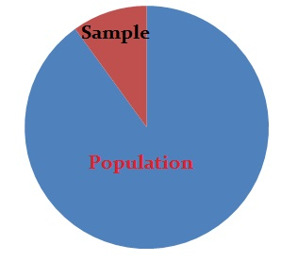
SS
A sample is a percentage of the total population in statistics. You can use the data from a sample to make inferences about a population as a whole.
Finding a sample size can be one of the most challenging tasks in statistics and depends upon many factors including the size of your original population.
A sample size is a part of the population chosen for a survey or experiment.

Slide 44
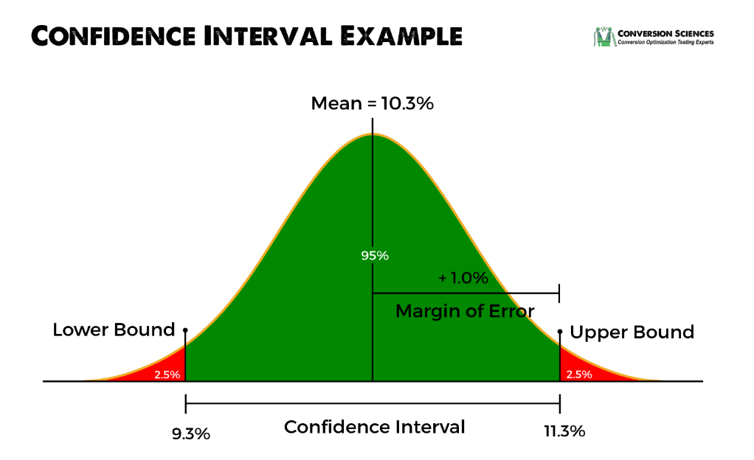
SS
When you only survey a small sample of the population, uncertainty creeps in to your statistics. If you can only survey a certain percentage of the true population, you can never be 100% sure that your statistics are a complete and accurate representation of the population. This uncertainty is called sampling error (SE) and is usually measured by a confidence interval (CI). For example, you might state that your results are at a 95% confidence level. That means if you were to repeat your survey over and over, 95% of the time your would get the same results.

Slide 45
How to Find a SS in Statistics
Conduct a census
(# of hospitalizations/year for Bronchiolitis in local hospital)
Use a sample size from a similar study
(Chances are, your type of study has already been undertaken by someone else)
Use a table
(For example, if you have an RCT, you may be able to use a table published in Machin et. al.’s Sample Size Tables for Clinical Studies, Third Edition)
Use a sample size calculator (online)
Use a formula (Cochran’s Sample Size Formula):
Where:
e-is the desired level of precision
p-is the (estimated) proportion of the population
which has the attribute in question
q-is 1 – p.
The z-value is found in a Z table.
Notes:
A pitfall: you’ll be relying on someone else correctly calculating the sample size. Any errors they have made in their calculations will transfer over to your study.

Slide 46
An Effective SS
An Effective sample size (or Adequate SS) in a study is one that will find a statistically significant effect for a scientifically significant event.
In other words: An effective SS ensures that an important RQ gets answered correctly.
An effective SS is partially dependent on what effect size you are willing to work with. The better effect size is the one that would detect smaller changes in experiment.
Halving the value of an effect size will generally quadruple the SS.

Slide 47
Biostatistics

Slide 48
Important Parameters
Hypotheses (H0 & HA)
Levels of Measurement or Types of Data
(Nominal, Ordinal, Interval, Ratio) (Independent vs. Dependent)
Example: A man (nominal) walked into my office and told me his joint pain was worse than last month (ordinal). His temperature was 101°F (interval) and his weight was down, at 126 lb. (ratio).
Confidence Interval (CI)
A 95% CI is a range of values that you can be 95% certain contains the true mean of the population.
Level of Significance
The significance level, also denoted as alpha or α is the probability of rejecting the null hypothesis when it is true. The researcher determines the significance level before conducting the experiment (p < α).
Power (or Strength) of the Study
The Power (1 – β) of a study is its ability to detect a difference, if the difference in reality exists.
Notes:
In 1925, Ronald Fisher advanced the idea of statistical hypothesis testing, which he called "tests of significance.“ Fisher suggested a probability of one in twenty (0.05) as a convenient cutoff level to reject the null hypothesis. In a 1933 paper, Jerzy Neyman and Egon Pearson called this cutoff the significance level, which they named α. They recommended that α be set ahead of time, prior to any data collection. p, is the probability of obtaining a result at least as extreme, given that the null hypothesis were true. The result is statistically significant, by the standards of the study, when p < α

Slide 49
CLINICAL IMPORTANCE vs. STATISTICAL SIGNIFICANCE
Clinical significance has little to do with statistics and is a matter of judgment. Clinical significance often depends on the magnitude of the effect being studied. It answers the question "Is the difference between groups large enough to be worth achieving?"
Studies can be statistically significant yet clinically insignificant and vice versa.
Minimally Important Difference (MID) generally refers to the smallest amount of change that matters to a patient.

Slide 50
Parametric vs. Nonparametric Statistical Tests
Parametric tests involve specific probability distributions (e.g., the normal distribution) and the tests involve estimation of the key parameters of that distribution (e.g., the mean or difference in means) from the sample data.
Nonparametric tests are sometimes called distribution-free tests because they are based on fewer assumptions (e.g., they do not assume that the outcome is approximately normally distributed).
Parametric tests are used when the information about the population parameters is completely known whereas non-parametric tests are used when there is no or few information available about the population parameters. In simple words, parametric test assumes that the data is normally distributed. However, non-parametric tests make no assumptions about the distribution of data.
Notes:
Biological data never follow a Gaussian distribution precisely, because a Gaussian or Parametric distribution extends infinitely in both directions, and so it includes both infinitely low negative numbers and infinitely high positive numbers! But many kinds of biological data follow a bell-shaped distribution that is approximately Gaussian. In some studies, the outcome is a rank. For example, in obstetrical studies an APGAR score is often used to assess the health of a newborn. The score, which ranges from 1-10, is the sum of five component scores based on the infant's condition at birth. APGAR scores generally do not follow a normal distribution, since most newborns have scores of 7 or higher (normal range).

Slide 51
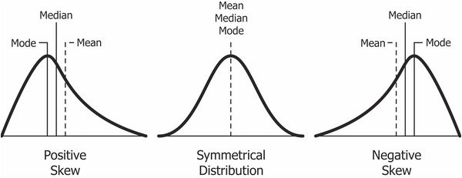
Reasons to Use Nonparametric Tests
Non-parametric tests deliver accurate results even when the sample size is small.
2. Non-parametric tests are more powerful than parametric tests when the assumptions of normality have been violated.
3. They are suitable for all data types, such as nominal, ordinal, interval or the data which has outliers.

Slide 52
A Guide for Selecting the Appropriate Stat. Test
Level of Outcome Measurement | 2 Independent Groups | 3 & more Independent Groups | 2 Matched or Dependent Groups | Multiple Measures in the Same Individuals | Association Between 2 Variables
Continuous Data | Independent or Unpaired t-test | Analysis of Variance (ANOVA) | Paired t-test | Repeated-Measures Analysis of Variance (ANOVA) | Linear Regression or Pearson Product Moment Correlation (r)
Nominal Data | Difference of Proportions or Chi-squared Test | Chi-squared (χ²) Test | McNemar’s Test |  | Logistic Regression
Ordinal Data | Mann-Whitney U Rank-Sum Test | Kruskal-Wallis Test | Wilcoxon Signed-Rank Test | Friedman Statistics | Spearman Rank Correlation (ρ)
Survival Time | Log-Rank test

Slide 53
What are the similarities between descriptive and inferential statistics? Both statistics rely on the same set of data. Descriptive statistics rely solely on the set of data, while inferential statistics also rely on this data in order to make generalisations about a larger population. What are the limitations of descriptive statistics? They only allow you to make summations about the people or objects that you have actually measured. You cannot use the data to generalize to other people or objects. For example, if you tested a drug to beat cancer and it worked in your patients, you cannot claim that it would work in other cancer patients only relying on descriptive statistics. Descriptive statistics can suggest an association between exposure and outcome, while Inferential statistics claim a possible causal relationship between exposure and outcome. What are the limitations of inferential statistics? Inferential statistics are based on the concept of using the values measured in a sample to estimate/infer the values that would be measured in a population. Some, but not all, inferential tests require the user to make educated guesses to run the inferential tests.

Slide 54
Questions?

