Slide 1

Dr. Teri Stuckless
Director, Office of Learner Well-Being and Success
teri.stuckless@med.mun.ca

Slide 2
This session is a part of your
Career
Counselling
Career Options
Applying to Residency

Slide 3
Career Options
Applying to Residency
MedCAREERS_I
Choosing the Right Career
(formerly Challenges & Choices)
Clerkship Preparation Course
CaRMS Document Preparation
MedCAREERS_II
Succeeding on the Wards
Early Prep for THE MATCH
Shadowing Orientation
OR Scrub Course
Year 1
Year 2
Year 3
Year 4
Phase 1
Phase 2
Phase 3
Phase 4
Pre-core Electives Discussion
(including international electives)
Elective/Selective Advice
(and introduction to online portal)
Choosing Electives

Slide 4
Physician Shadowing
Introductions
Physician Shadowing Overview
Guidelines & Training
Q & A
Sign-Up

Slide 5
Introductions
Ms. Lauren Law Class of 2025
llaw@mun.ca
Ms. Zoe Breen Class of 2024
zoe.breen@mun.ca
Anders Jensen LWS Office
medadvising@mun.ca
Notes:
Ask Kalen and Erin to come and talk to the class.

Slide 6
Physician Shadowing Overview
Voluntary
    for both students and physicians
Mentoring & Networking

Slide 7
Objective
Physician Shadowing can help with specialty decision-making by enabling learners to observe what it is like to practice in different specialty areas.

Slide 8
Overview
Facilitate early specialty exploration
  Start process as you begin Phase II
Exposure to a range of specialties
Observational plus Minor Procedures (supervised)
  Does not entail patient care or service provision
  Max: 12hr/wk
  Keep a log

Slide 9
Timelines
Sept/Oct - | Specialty selection forms circulated Matching with participating physicians completed Shadowing Orientation Session for Class of 2025
Sept 2021 | Class of 2024 students are eligible to shadow
Jan 2022 | Class of 2025 students are eligible to shadow
June – August | Volunteers contact physicians for next year

Slide 10
Forms
Guidelines & Training
Visit our website:
https://www.med.mun.ca/https/www-med-mun-ca/Student-Affairs/Career-Advising/Physician-Shadowing-aspx.aspx
Shadowing Hours Log
Learner Specialty Selection Form
Learner Shadowing Card
Notes:
These forms are available on our website under Physician Shadowing.
We need these forms for insurance purposes, if there is a malpractice, then we need documentation that you were there, that we knew, and for how long u were there.
For that block of time between june and sept, if you want to leave and go somewhere else and do shadowing, then we need to know. UGME needs to approve this, for insurance purposes. Its not part of shadowing, and not part of electives, so not covered. Students have done that in the past, but majority do fall under physician shadowing. They can email us, or drop by our office, or drop by UGME.

Slide 11
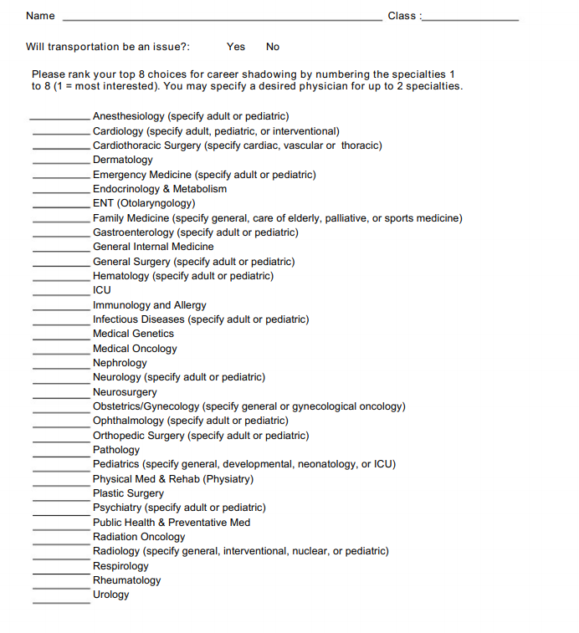
Specialty Selection Form
Notes:
These are the specialties that are offered here and with CaRMS.
They are filled in by the students and submitted to the Shadowing Coordinators.

Slide 12
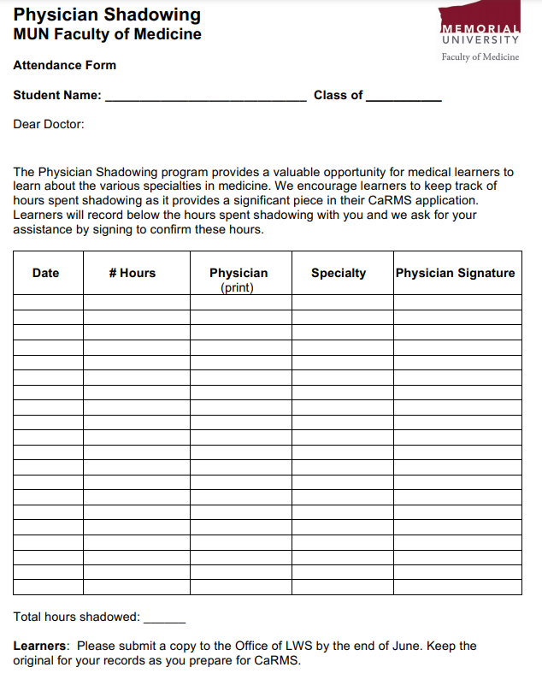
Shadowing Hours Log
Notes:
These are the specialties that are offered here and with CaRMS.
They are filled in by the students and submitted to the Shadowing Coordinators.

Slide 13
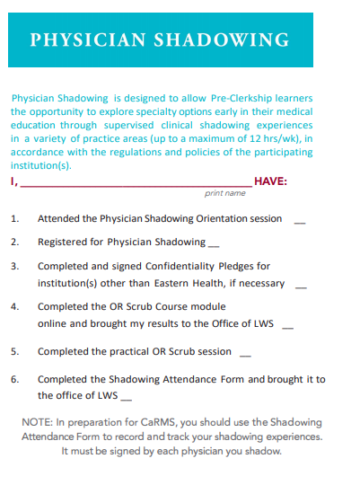
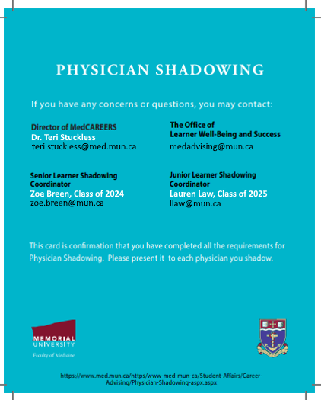
Shadowing Card
Notes:
Some items have already been signed for you.
The OR Nurse Educators will sign for completion of OR training when you do the practical.
Show this card each and every time you attend a shadowing session.

Slide 14
Training
  You have signed:
  Personal Health Information Act (PHIA)
  Eastern Health Confidentiality Agreement
  * If you go to another institution, you will have to sign their Confidentiality Agreement

Slide 15
Training
  Complete Surgical Orientation (online module, D2L)
  You need 90% to pass and a copy of the results must be submitted to the Office of Learner Well-Being and Success
  Practical Scrub Course
  Groups of 8 or 9 in one of 4 OR sites
  List to be circulated, scheduled Nov-Dec
  Must be completed prior to surgical shadowing
Notes:
15
Erin can talk about this if she is available.

Slide 16
Responsibilities
Follow relevant policies and guidelines
  MUN Faculty of Medicine
  Eastern Health (EH)
  Other Health Boards
  Hospitals (in all provinces/states)
Notes:
Students participating in Physician Shadowing should know that they are bound by all policies and regulations of the organizations and facilities in which they spend their time.
Most shadowing occurs within Eastern Health, so students should familiarize themselves with policies of EH.
When shadowing at other institutions (e.g., Central Health), students should familiarize themselves with their policies.

Slide 17
CPSNL: Responsibilities of Undergraduate Students
An Undergraduate Student is not an independent practitioner.
An Undergraduate Student is completing his/her undergraduate curriculum and as such, requires supervision in the performance of his/her clinical duties.

Slide 18
CPSNL: Responsibilities of Undergraduate Students
An Undergraduate Student must:
  Participate in the care of patients as appropriate to his/her competencies and specific circumstances
  Ensure that his/her Supervisor is aware of his/her level of training and experience with clinical and technical procedures to ensure adequate supervision
  Make the patient aware of his/her name and role as a Student
  Communicate effectively with the Supervisor
  Maintain a professional relationship with his/her Supervisor, patients and their families, colleagues, and staff
  Abide by the curricular expectations, guidelines and codes of the Faculty of Medicine, MUN.

Slide 19
Personal electronic devices
Cell Phone Use
Personal
Mobile phone usage within EH
“Use of personal cell phones in the presence of a patient or in the workplace during working hours will result in discipline.” - Marilyn Nichols, Director, Employee and Labour Relations
Notes:
See emails and update accordingly

Slide 20
Needle Stick Injury
https://www.med.mun.ca/needlestick
Student will proceed to ER department for medical assessment by the ER physician

Slide 21
Social Media
https://www.med.mun.ca/getdoc/baf3d179-eaf3-4508-aaa5-6dc3880240cd/Social-Media-Guidelines-2016-11-14.aspx
You can’t be too careful!
Do not post ANY details regarding clinical encounters
Do not post anything negative

Slide 22
What if I want to arrange my own shadowing?
Please remember:
Students who are registered to shadow will be covered by the medical malpractice insurance provided by MUN through CURIE (Canadian Universities Reciprocal Insurance Exchange).
Non-Compliance
There is no guarantee of coverage for students who are not registered.

Slide 23
If shadowing over the summer:
Email medadvising@mun.ca:
Your Name
Physician’s Name
Location
Date(s)
Remember to complete the physician participation form and submit to
LWS.

Slide 24
Shadowing Policy
Out of province experiences:
  In Canada
    You are responsible to be aware of and adhere to provincial College regulations/policies.
  International
    We do not support non-Canadian shadowing experiences

Slide 25
Tips
  Follow through on commitments
  Communicate effectively
  Dress appropriately
  Be respectful
  Document your shadowing experience

Slide 26
Advice
Come to clinic prepared.
  Read about the specialty
  Ask relevant questions
Set clear goals with your preceptor and make sure you are on the same page.
Don’t do anything that doesn’t feel right.
Discuss with me!

Slide 27
Appreciation
Upon finishing a shadowing experience, consider sending your preceptor a letter of thanks and appreciation.

Slide 28

Thank you!
Sign-Up Now!

